Slide 2
How Microsoft Builds Software and Services like Windows, powered by
Azure DevOps
BRK1097
Jill Campbell – GPM, Windows Engineering Systems
Edward Thomson – Program Manager, Azure DevOps

Slide 3



Azure DevOps
@AzureDevOps
https://azure.com/devops
#AzureDevOps

Slide 4
What is DevOps?
People. Process. Products.
Build& Test
Deploy
DevOps is the union of people, process, and products to enable continuous delivery of value to your end users.
“
Continuous
Delivery
Develop
Operate
”
Plan
&
Track
Monitor
&
Learn

Slide 5





Introducing Azure DevOps
Azure Boards
Azure Pipelines
Azure Repos
Deliver value to your users faster using proven agile tools to plan, track, and discuss work across your teams.
Build, test, and deploy with CI/CD that works with any language, platform, and cloud. Connect to GitHub or any other Git provider and deploy continuously.
Get unlimited, cloud-hosted private Git repos and collaborate to build better code with pull requests and advanced file management.
Azure Test Plans
Azure Artifacts
➔
Test and ship with confidence using manual and exploratory testing tools.
Create, host, and share packages with your team, and add artifacts to your CI/CD pipelines with a single click.
https://azure.com/devops

Slide 6
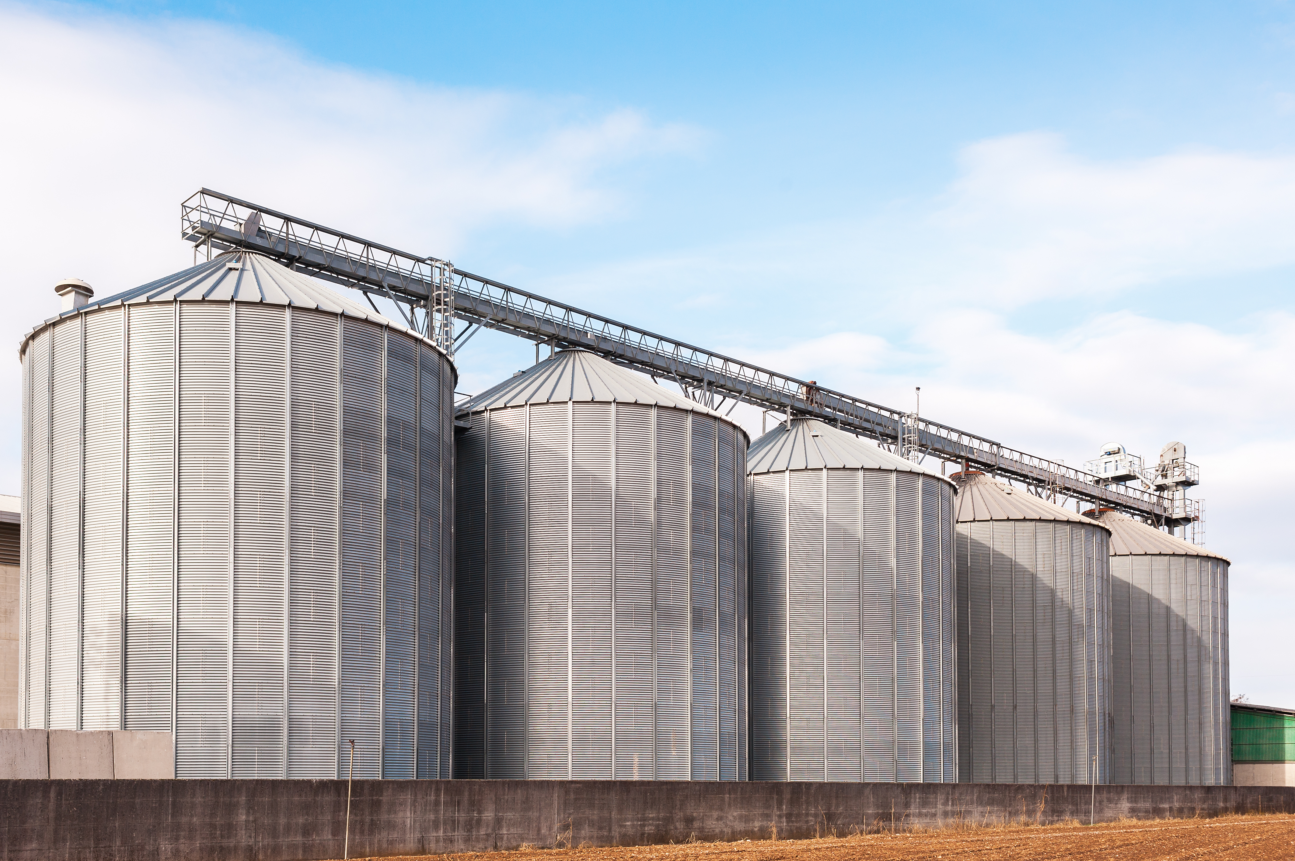
Before Azure DevOps

Slide 8

One Engineering System (”1ES”)
There cannot be a more important thing for an engineer, for a product team, than to work on the systems that drive our productivity.
So I would, any day of the week, trade off features for our own productivity.
I want our best engineers to work on our engineering systems, so that we can later on come back and build all of the new concepts we want.
- Satya Nadella

Slide 9

One Engineering System with Azure DevOps

Slide 10

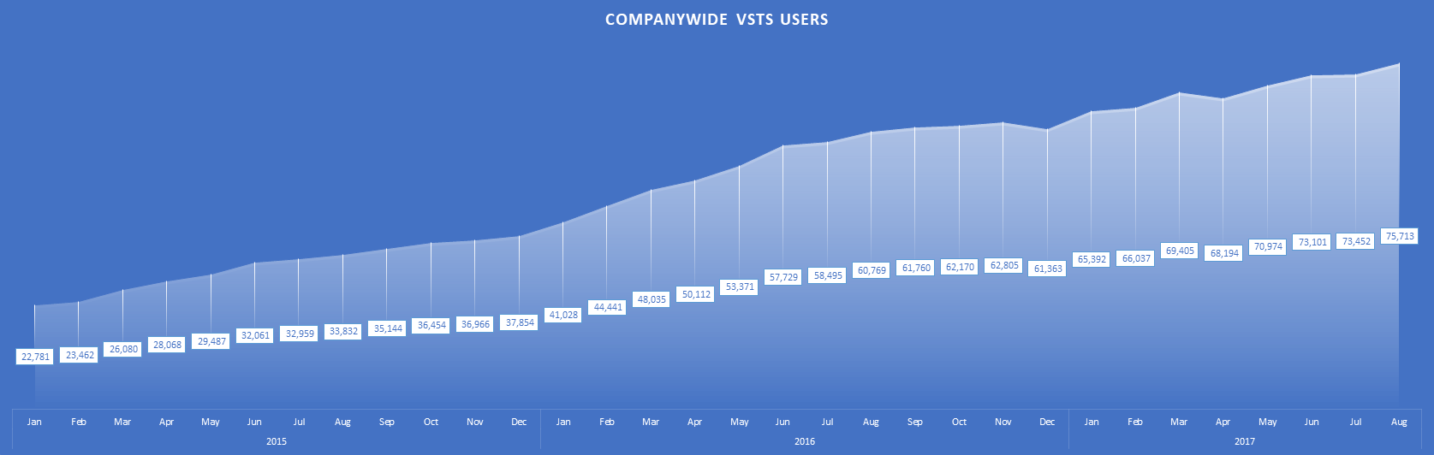
Azure DevOps: Most of Microsoft
Visual Studio Team Services
Company wide engaged users of Azure DevOps in the Microsoft organization (Aug 2017)

Slide 11
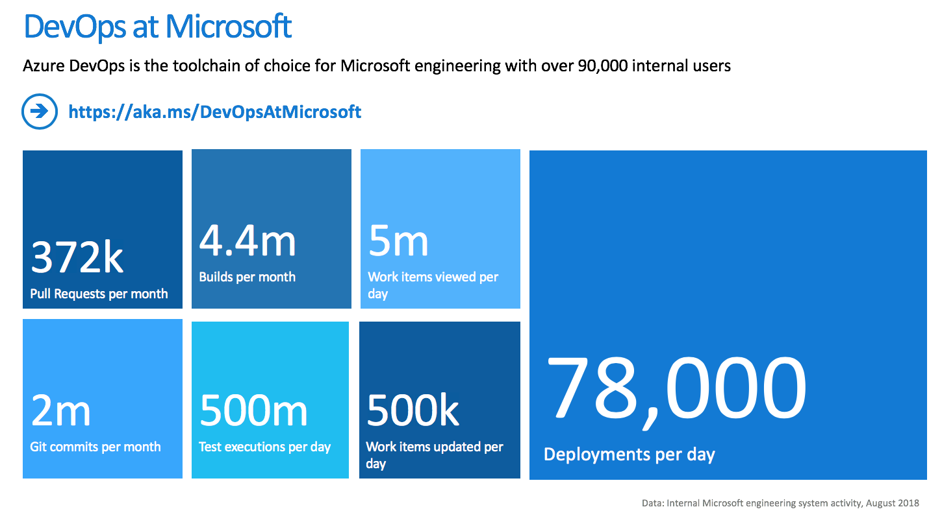
1ES Adoption within Microsoft

Slide 12

One Engineering System with Azure DevOps
Azure Networking

Slide 13


Slide 14
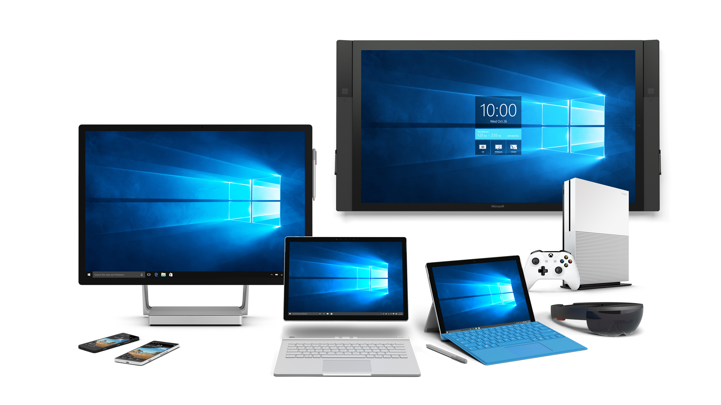


Slide 15
Software Products
500GB+
Source code
6000+
Repos
SERVICES
APPS
EDITION SPECIFIC CODE
Xbox
Desktop
Server
IoT
Hololens
Hub
Desktop
OneCore
COMMON OS CORE
DRIVERS

Slide 16






Windows and Devices is Larger Than Many Companies
14,000
Employees
22,352
Employees
19,000
Employees
16,000
Employees
3,900
Employees
3,100
Employees

Slide 17
Scale
11,985
Software Engineers in WDG that need to work together
7,305
Developers bringing in code to WDG repos
3,974,374
Commits in Fall Creator’s Update (RS3) development timeframe
497,903
Pull Requests for RS3
68,646
Official Lab builds for RS3
1,159
Machine years of build resources for RS3 Lab builds
4,201,457
Developer desktop RS3 builds
949
Machine years for test resources during RS3
3,188,972,675
Test cases executed during RS3

Slide 18
Frequency
Multiple Daily
Windows Defender signature updates
Store and Services updates
Weekly
Windows Servicing updates
Daily - Biweekly
Windows Store Apps updates
Monthly
Xbox updates
Semiannually
Windows feature updates
18-24mos
Device releases

Slide 19



Slide 20
Agile Planning,
Work Items,
Burndown

Slide 21

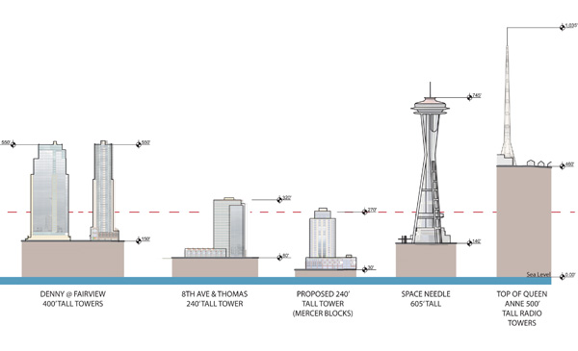

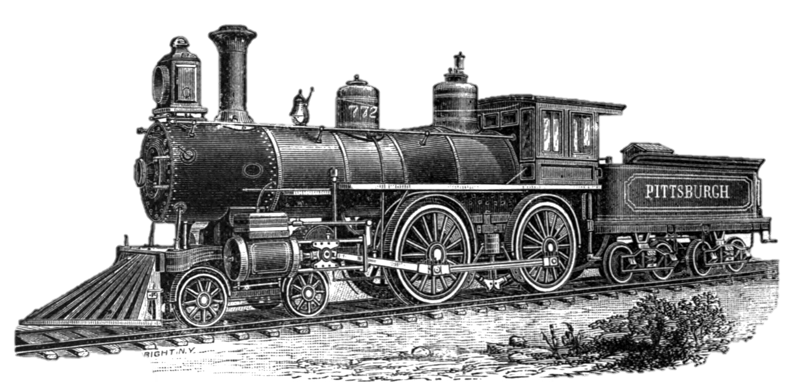
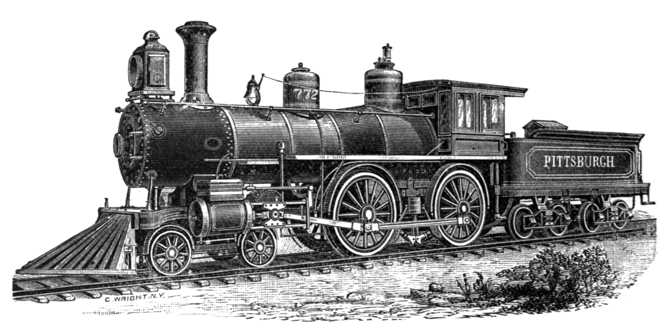


11,000 ENGINEERS CREATE A LOT OF STUFF…
11M
Work Items
5.5
Space Needles
If every one were a sheet of paper, it would be as tall as
350M
Revisions
2
Steam Engines
If every one were a feather, it would weigh as much as
2.54M
Queries &
Updates /day
Chicago
Illinois
If every one were performed by a human, it would be the population of

Slide 22
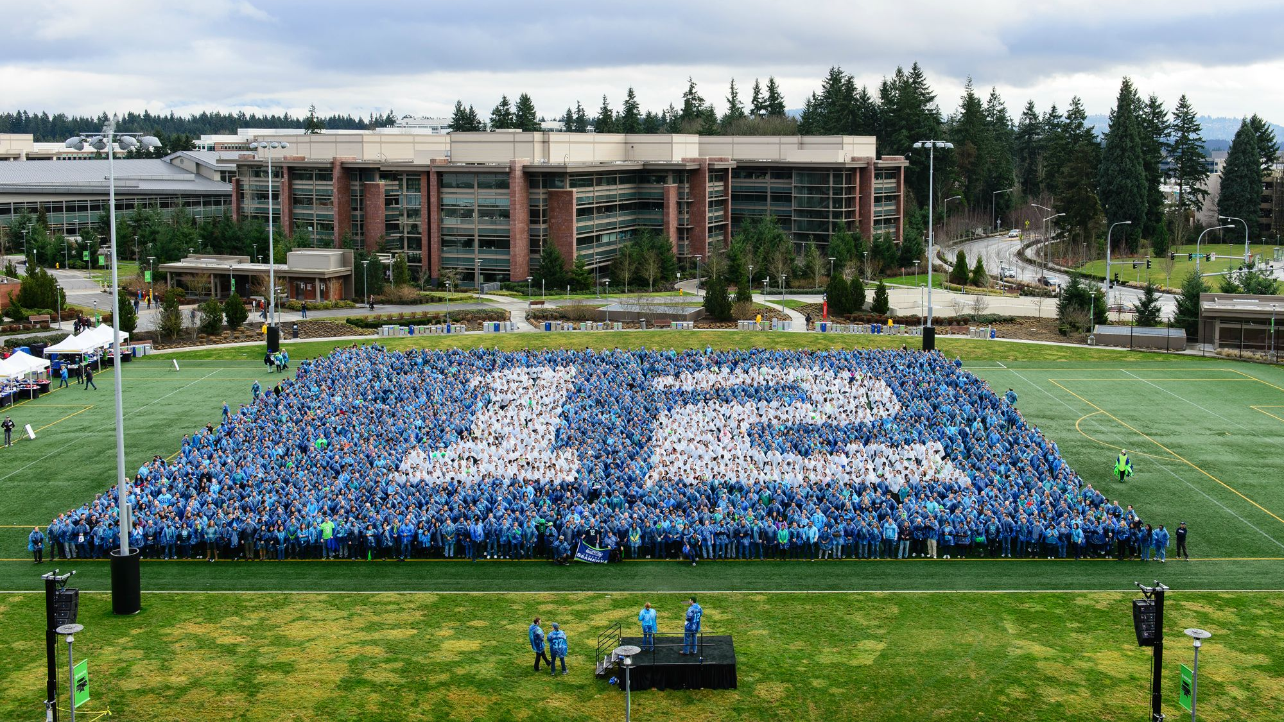
HOW DO YOU GET 11,000 SOFTWARE ENGINEERS TO WORK
INDEPENDENTLY
AND TOGETHER?

Slide 23

See Far
Able to align to long-term work like silicon bringup and HW development cycles
Able to describe an end-state that we want to achieve in a 1 yr+ timeframe which we can share or use as an input as needed
High enough predictability to manage dependencies and shared commitments
Operate Nimbly
Able to start moving quickly and iterate
Able to adapt or adjust plans quickly based on changing information
Able to experiment and develop options
Low overhead engineering processes

Slide 24
Taxonomy Enables Alignment and Autonomy
Story
Scenario
Deliverable
Customer Promise
Task
Defines the Product we’re building
Describes the work required to build it

Slide 25
TAXONOMY BY THE NUMBERS, IN RS4
Story
Scenario
Deliverable
Customer Promise
Task
43 Stories
206 Customer Promises
3,342 Scenarios
38,864 Deliverables
143,408 Tasks

Slide 26
Three Big Problems to Solve
The Big Picture
Seeing “The Big Picture” in that sea of data
Dependencies
Finding the key work that the release and other teams are dependent on
Team Execution
Helping the teams monitor their work, their stats, and figuring out where things go

Slide 27
Demo
Trackers

Slide 28
Git and
Version Control

Slide 29
Coding
ON AVERAGE, EACH MONTH
7.3K |  | Developers making code changes
11K |  | Topic branches
367K |  | Commits
33K |  | Pull requests
9.7K |  | Branch Integrations
10 commits per minute
1,100 pull requests per day

Slide 30
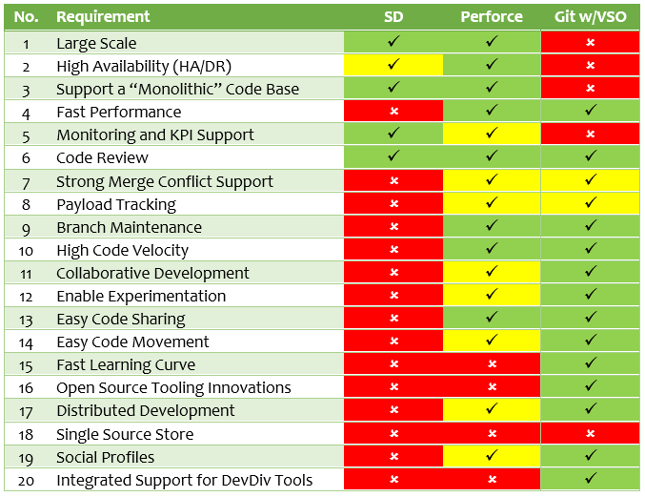
Why Did We Pick Git as a Starting Point
|
|
Evaluated Git against Source Depot
Found Git was the only solution that could meet all our needs
Source Depot

Slide 31
Git
Roslyn
Linux
34MB
230MB
640MB
3k | files
90MB | pack file
292KB | index file
12k | files
219MB | pack file
1.8MB | index file
57k | files
1.7GB | pack file
5.5MB | index file

Slide 32
Azure
Compute
500 MB
44k | files
1.5GB | pack file
7MB | index file
150 | users

Slide 33
Azure
Compute
VSTS
500 MB
3GB
44k | files
1.5GB | pack file
7MB | index file
150 | users
110k | files
8GB | pack file
16MB | index file
300 | users

Slide 34
Windows
360GB
Azure
Compute
VSTS
500 MB
3GB
44k | files
1.5GB | pack file
7MB | index file
150 | users
110k | files
8GB | pack file
16MB | index file
300 | users
3.5M | files
86GB | pack file
400MB | index file
7,000 | users

Slide 35
Git on Windows repository
12 hrs
3 hrs
8 mins
30 mins
clone
checkout
status
commit

Slide 36
With Virtual Filesystem for Git (formerly GVFS), you only download the content from the repository that you need, and you download it on-demand.

Slide 37
Git + GVFS on Windows repository
12 hrs
3 hrs
8 mins
30 mins
5 mins
30 secs
8 secs
6 secs
clone
checkout
status
commit

Slide 38
Virtual Filesystem for Git
win32src1.cpp
win32src2.cpp
Azure
Repos
win32src3.cpp
VFS Driver
win32src4.cpp
win32src5.cpp

Slide 39
Virtual Filesystem for Git
win32src1.cpp
win32src2.cpp
win32src2.cpp
Azure
Repos
win32src3.cpp
VFS Driver
win32src4.cpp
win32src5.cpp

Slide 40
Virtual Filesystem for Git
win32src1.cpp
win32src2.cpp
win32src2.cpp
Azure
Repos
win32src3.cpp
VFS Driver
win32src4.cpp
win32src5.cpp

Slide 41
Virtual Filesystem for Git
win32src1.cpp
win32src2.cpp
win32src2.cpp
Azure
Repos
win32src3.cpp
VFS Driver
win32src4.cpp
win32src5.cpp
win32src5.cpp

Slide 42
Virtual Filesystem for Git
Application
VFS for Git Filter Driver
NTFS Filesystem C:\

Slide 43
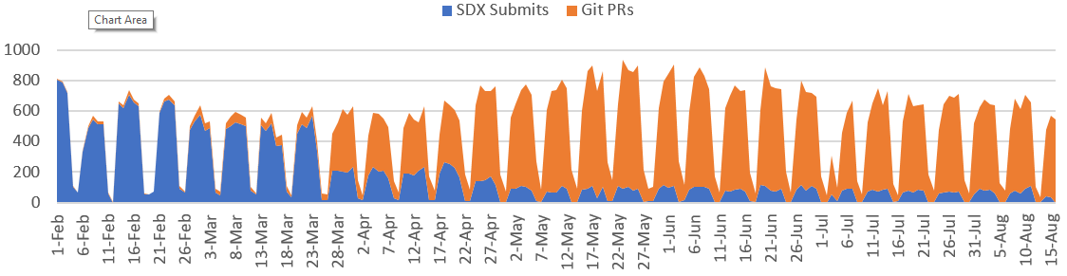
Git Crossover – No Drop in Productivity
Git Onboarding Schedule & Productivity Impact (Git Pull Request/SDX Submit Measures)
ES
Onboard
2/4
Fundamentals
Onboard
2/25
OneCore
& Edge
Onboard
3/25
Shell, Apps,
Xbox, IOT, LOC
Onboard
4/22
Server
Common
Onboard
5/13
Analog
Onboard
8/21

Slide 44
Build,
Deploy, and
Monitor

Slide 45



How Do We Flow All That Code?
MASTER
TOPIC
TOPIC
TOPIC
TOPIC
TOPIC
Developer Private Loop

Slide 46
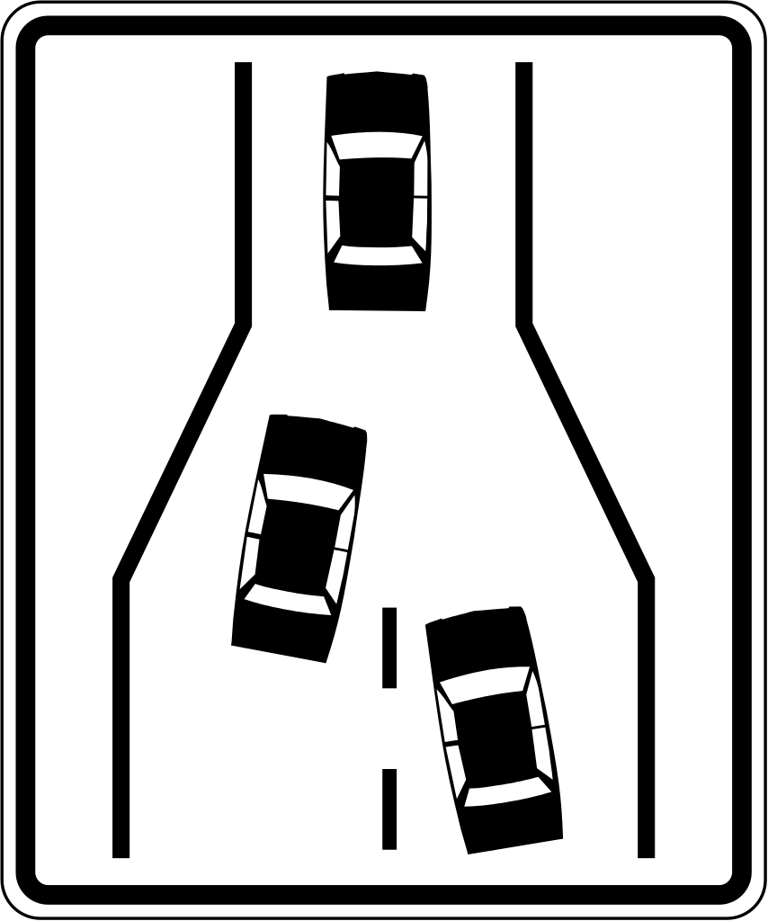

Slide 47
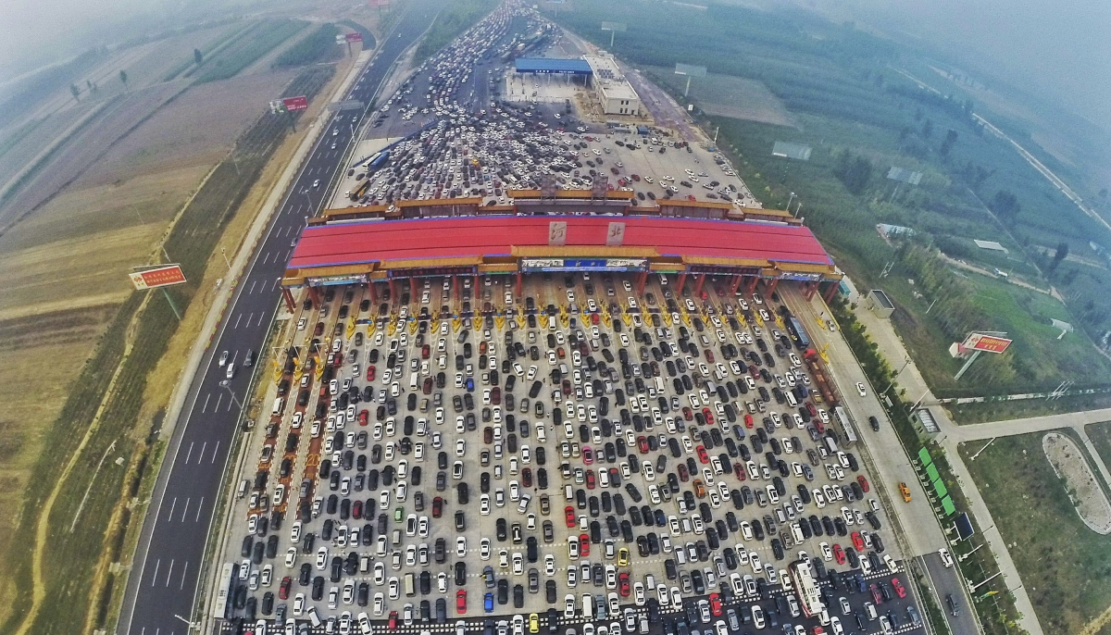
china.org.cn

Slide 48
Branching to Isolate Development
LEVELS | BUILDS | CHANGES | DEVS
L0 | 1.2% | 0.3% | 0.7%
L1 | 12.3% | 7.3% | 8.2%
L2 | 35.3% | 30.5% | 36.5%
L3 | 47.2% | 59.9% | 52.3%
MASTER
INTEGRATION
INTEGRATION
INTEGRATION
INTEGRATION
INTEGRATION
INTEGRATION
WORKING
WORKING
WORKING
WORKING
WORKING
WORKING
WORKING
WORKING
Developer Private Loop

Slide 49
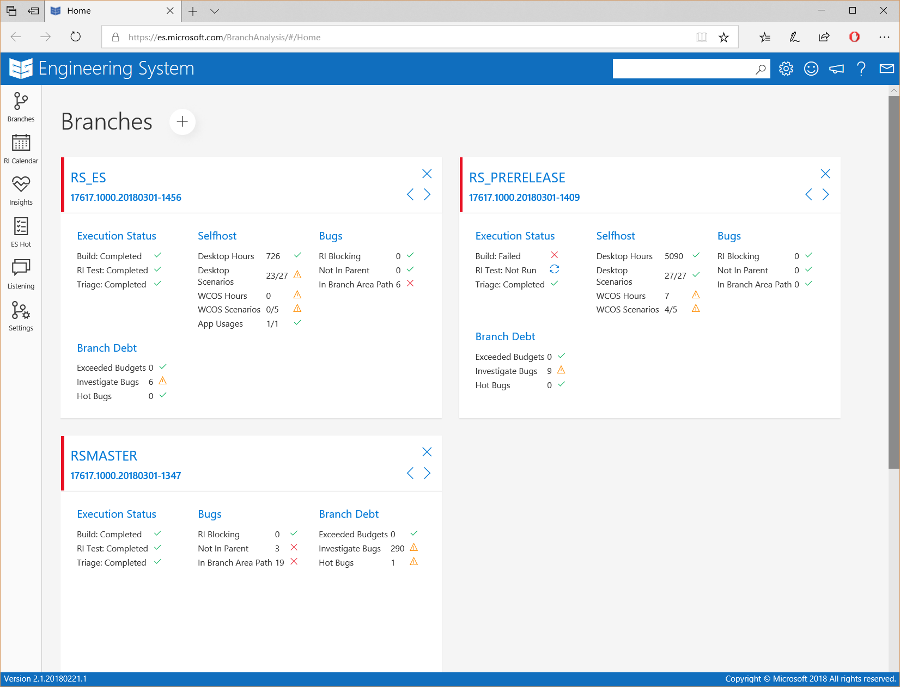
Each branch has an owner, who tracks daily lab builds and makes decisions about when code is stable enough to move up to master

Slide 50
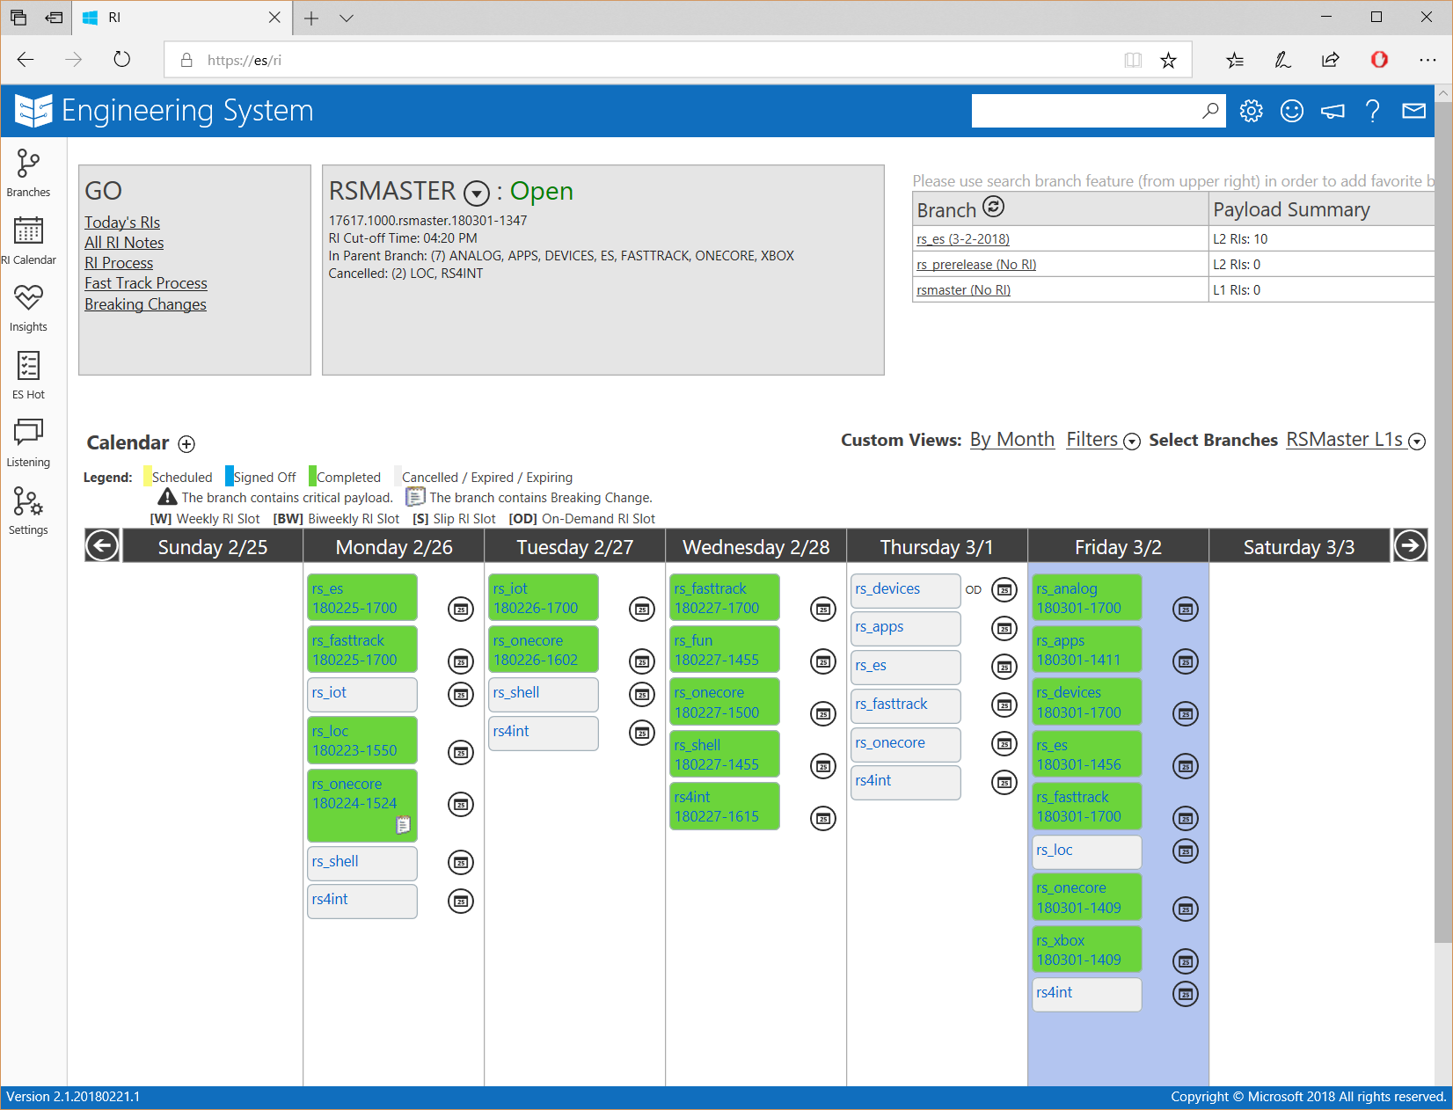
Payload from lower branches is moved up to the parent in a “reverse integration” (RI)
New payload comes down from parent branches in a “forward integration”

Slide 51
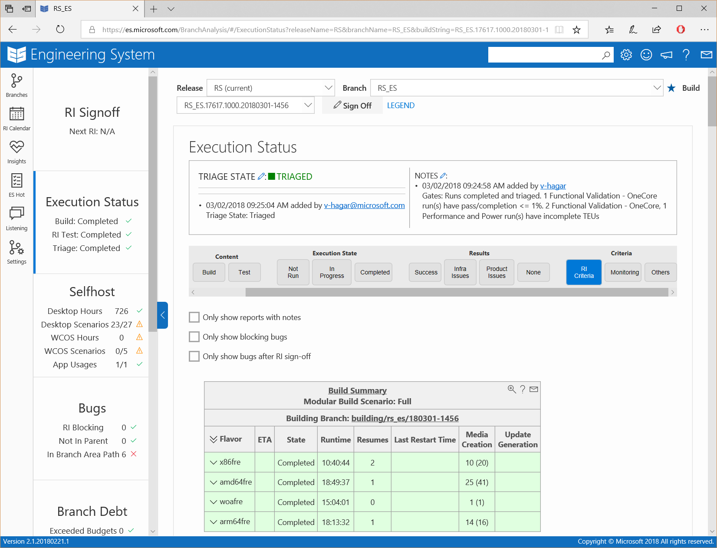
Branch owners monitor the health of their branch.
This includes things like Build and test results, and failure triage

Slide 52
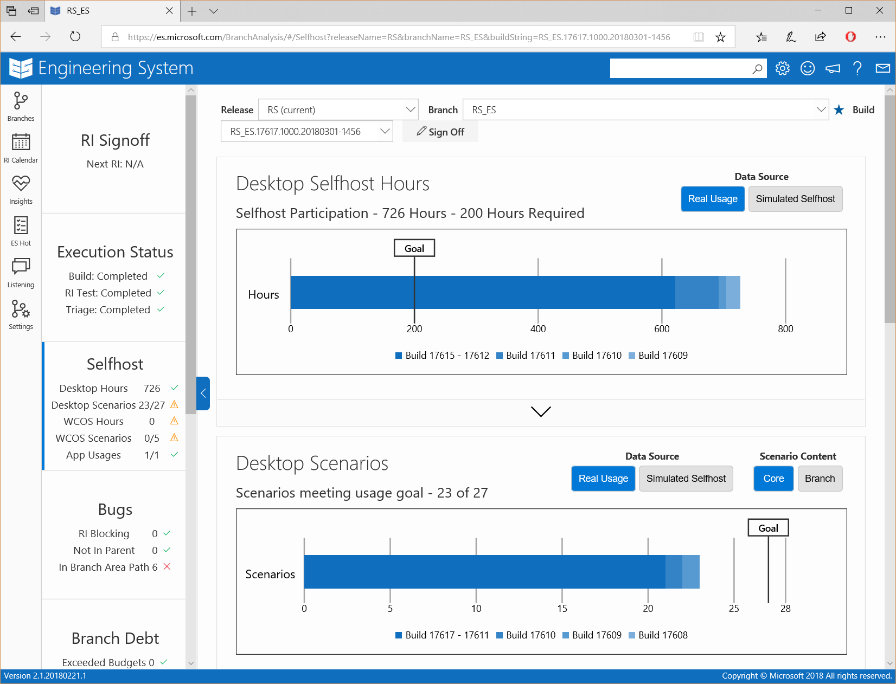
As well as selfhost usage from engineers using their branch

Slide 53
But Isolation Can Create Time Challenges
LEVELS | BUILDS | CHANGES | DEVS
L0 | 1.2% | 0.3% | 0.7%
L1 | 12.3% | 7.3% | 8.2%
L2 | 35.3% | 30.5% | 36.5%
L3 | 47.2% | 59.9% | 52.3%
MASTER
INTEGRATION
INTEGRATION
INTEGRATION
INTEGRATION
INTEGRATION
INTEGRATION
WORKING
WORKING
WORKING
WORKING
WORKING
WORKING
WORKING
WORKING
Developer Private Loop

Slide 54
Which is why we’re working with Azure Repos on a Windows-Scale PCV
MASTER
WORKING
WORKING
WORKING
WORKING
Pre-checkin Validation (PCV)
TOPIC
TOPIC
TOPIC
TOPIC
TOPIC
Developer Private Loop

Slide 55


Pre-Checkin Validation
WORKING
BRANCH
Prepped as
LKG
Build
Latest changes
Synced and built in
ROLLING BUILDS
Successful
BUILD?
Successful
TEST?
Pre-Checkin
BUILD
Pre-Checkin
TEST
Once Pre-Checkin Criteria are met Developer can make a
PULL REQUEST
Combined with scoped
CHANGES FROM DEV
TOPIC BRANCH
Developer makes code
CHANGES IN TOPIC BRANCH

Slide 56
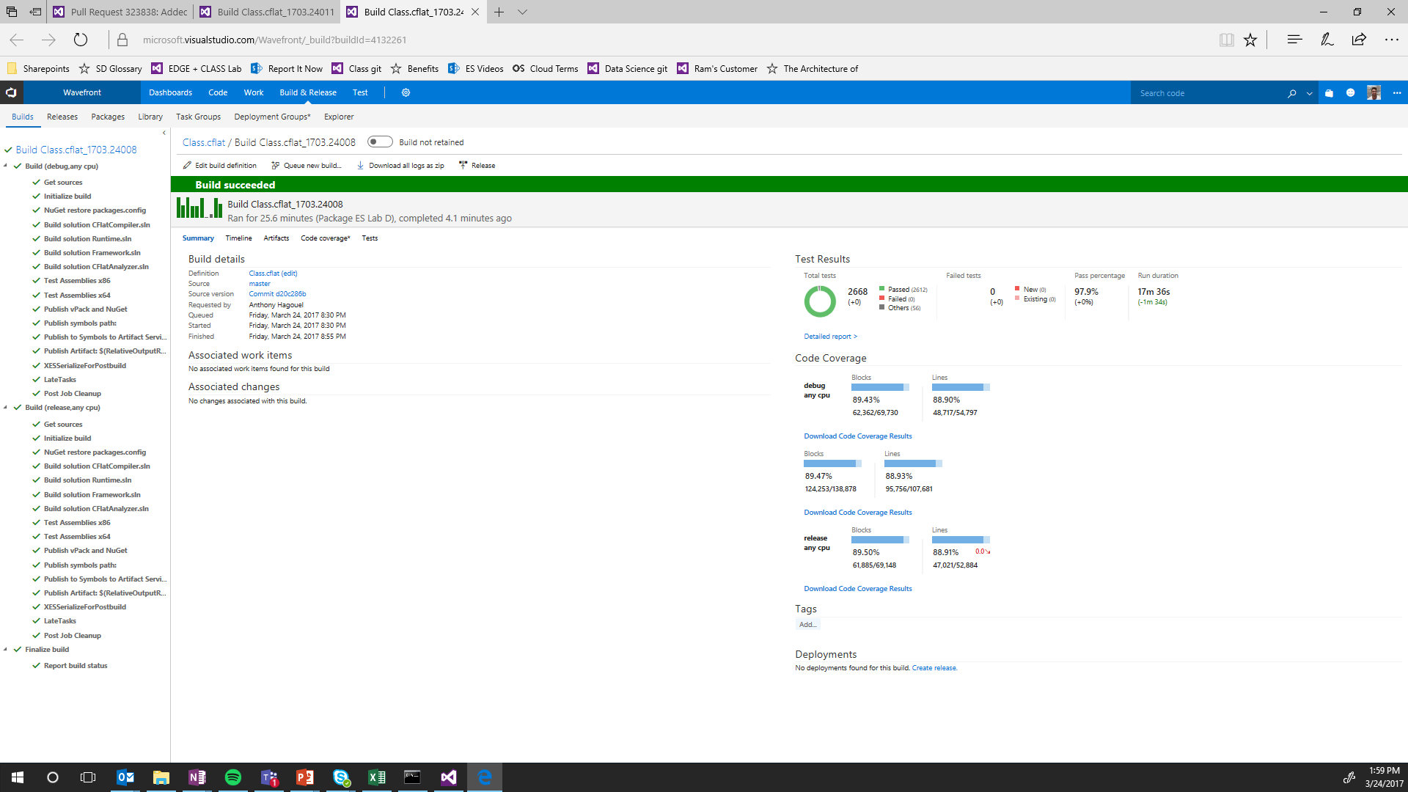

Slide 57

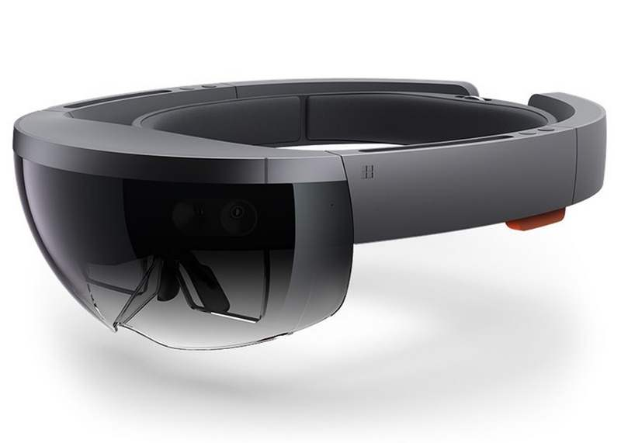
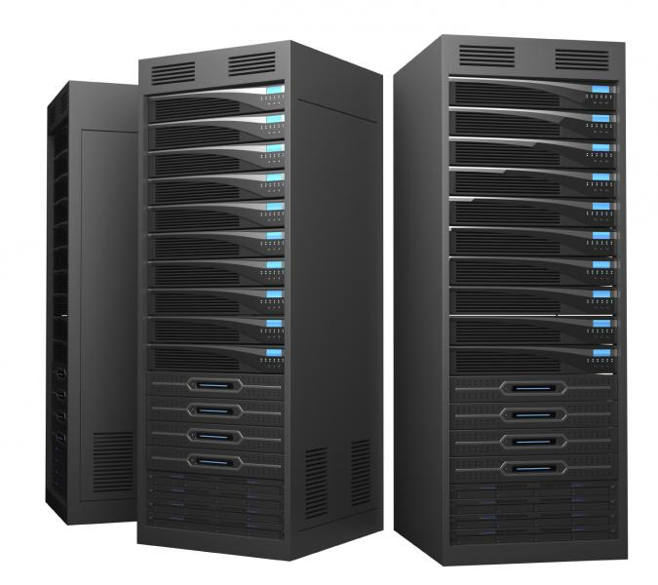

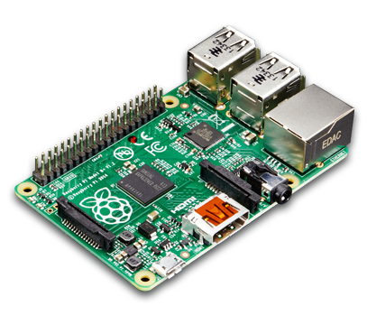
For 1 Day of Automated Lab Testing
We need…
2,511
Desktop PCs
246
HoloLens
1,214
Virtual Machines
346
Xboxes
46
IoT Devices

Slide 58

Windows Insider Program
Launched for Windows 10 development cycle
Listening to our customers

Slide 59

Why Insiders?
Long History of Beta Programs
Complexity
    8.5M Unique Devices
    21.2M Unique Apps
    [N] Configuration Options
Latency
    By the time people saw our work, it was too late to give feedback
$$\left({n \atop r}\right)$$
Easily exceeds the number of atoms in the observable universe
(Fortunately in the real world these things tend to cluster, but it’s still a big set)

Slide 60
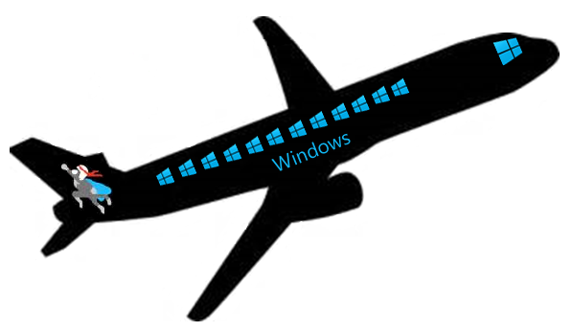
Windows Development in the Open
25 public previews
28 public previews
1 public preview
3 public previews
2 public previews

Slide 61
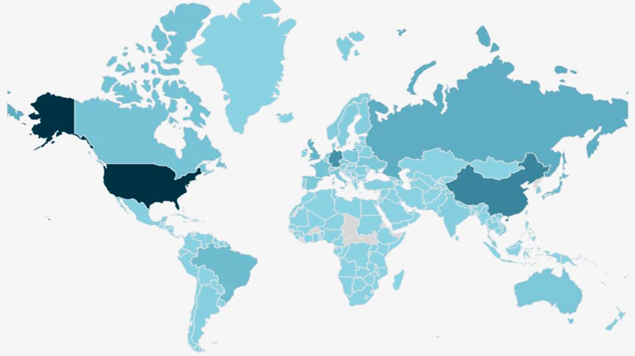
Insiders are worldwide
  Every country in the world has Insiders, covering ~ 95% of hardware components found on PCs

Slide 62
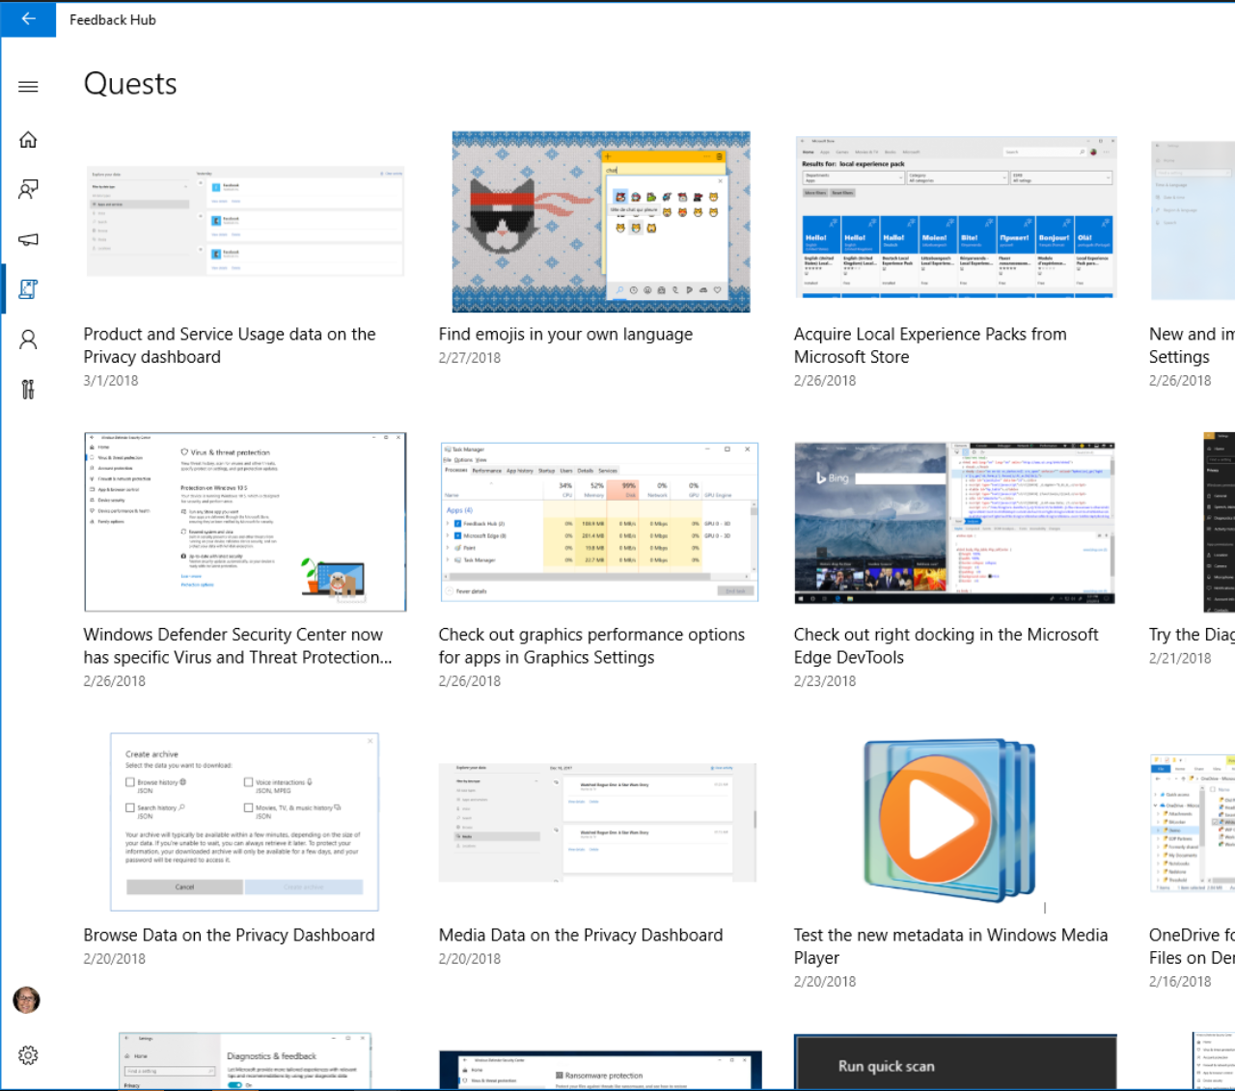
1.64M
quests
Completed since Oct 2016

Slide 63

THANK YOU

Slide 64

438,000
Insider problem reports fixed
since Oct 2016

Slide 65
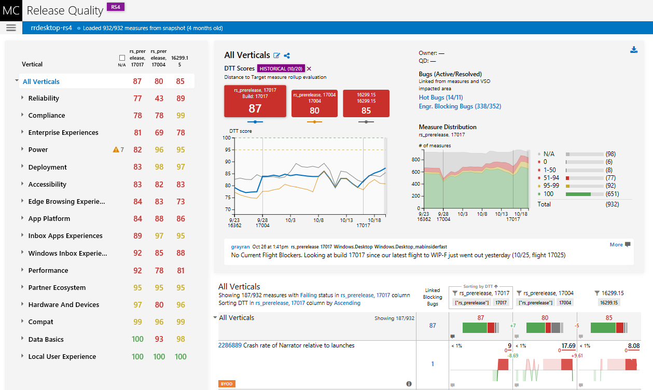
Insider Data Informs Release Decisions

Slide 66

SHARING IS CARING

Slide 67



Sharing Our Code Internally, In an Open Project
Areas
Owners
Features available now in an open Microsoft project
Trackers
Widgets
Dev Productivity
Open Microsoft backlog projects

Slide 68

Now Sharing That Same Code Out with the World

Slide 69
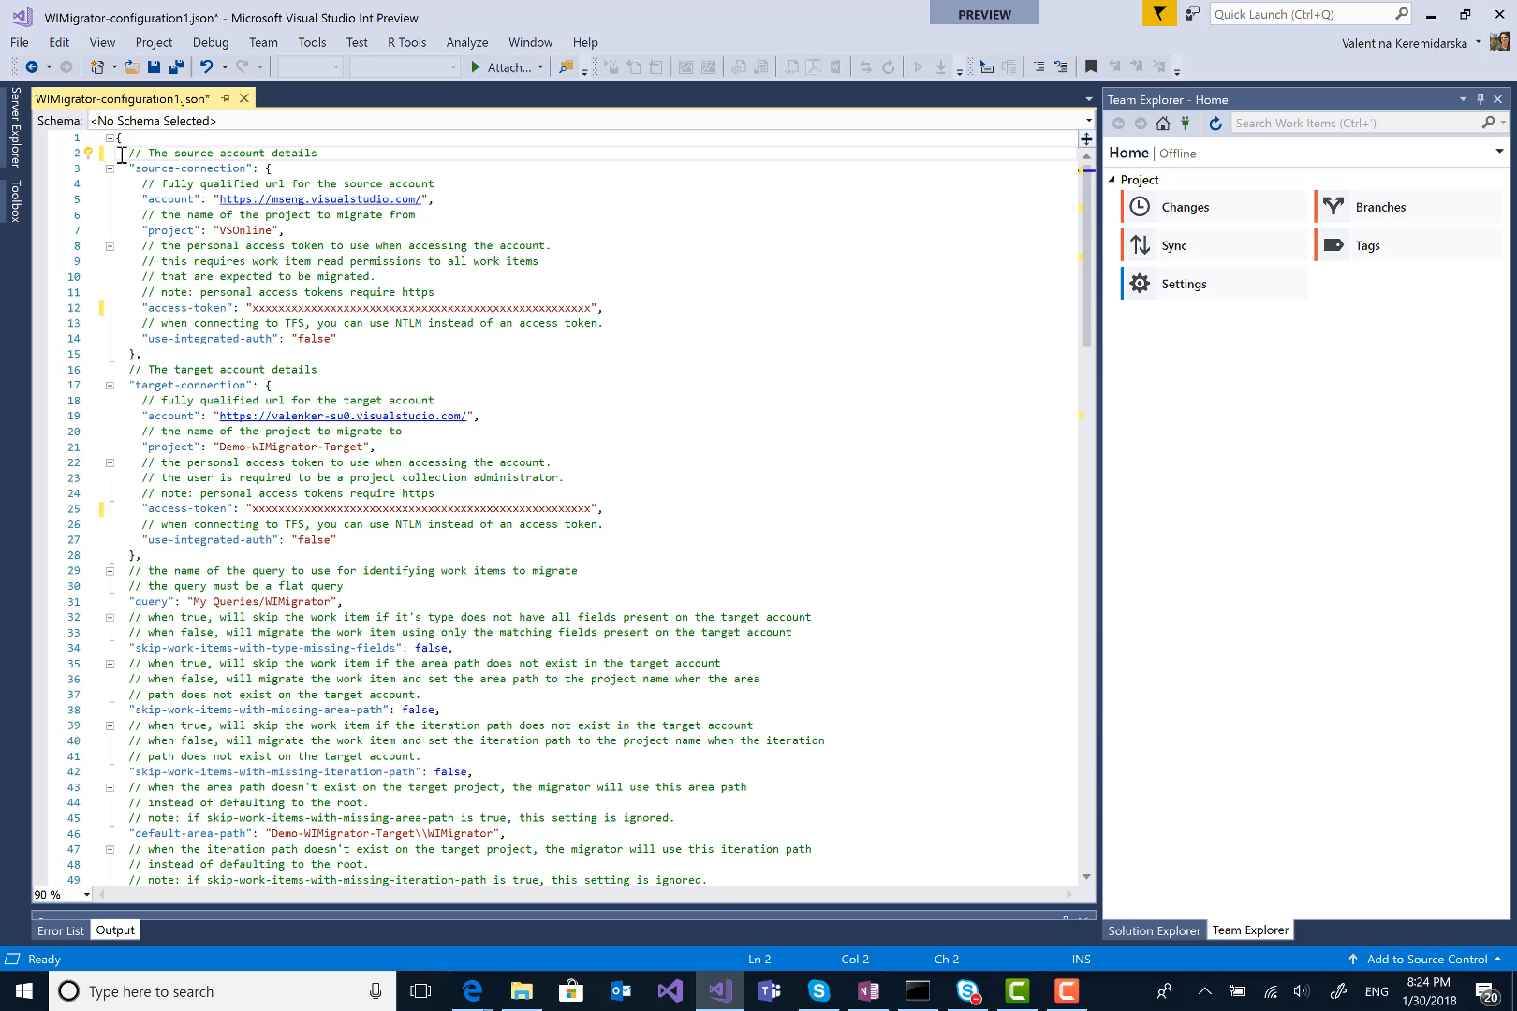
http://Aka.ms/WiMigrator
WORK ITEM MIGRATOR
WiMigrator is a command line tool for migrating work items between VSTS/TFS projects. This tool was built to archive of the WDG account, but is a general purpose tool for any time work items need to be migrated between accounts.
Features:
Migrate the latest revision of a work item or set of work items based on the provided query, including:
Work item links (for work items within the query results set)
Attachments
Git commit links (link to the source git commit)
Work item history (last 200 revisions as an attachment)
Tagging of the source items that have been migrated

Slide 70
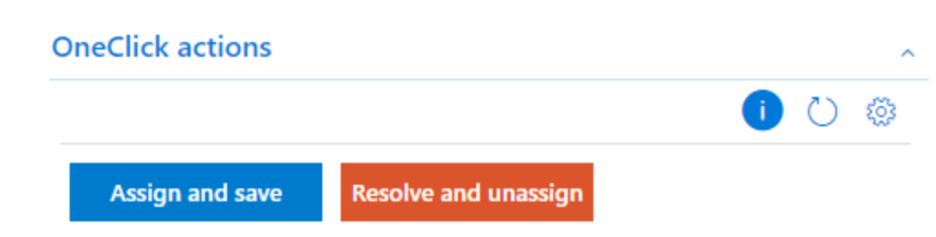
http://Aka.ms/WorkItemOneClick
WORK ITEM ONE CLICK
Built to help create personalized default values that can be used on any form with “one click”, the work item form group extension lets users perform multiple actions on a workitem by just a single click. It shows up as a group in work item form where users can manage and perform one click actions. These rules are based on current work item type, project and user's rule subscriptions.

Slide 71
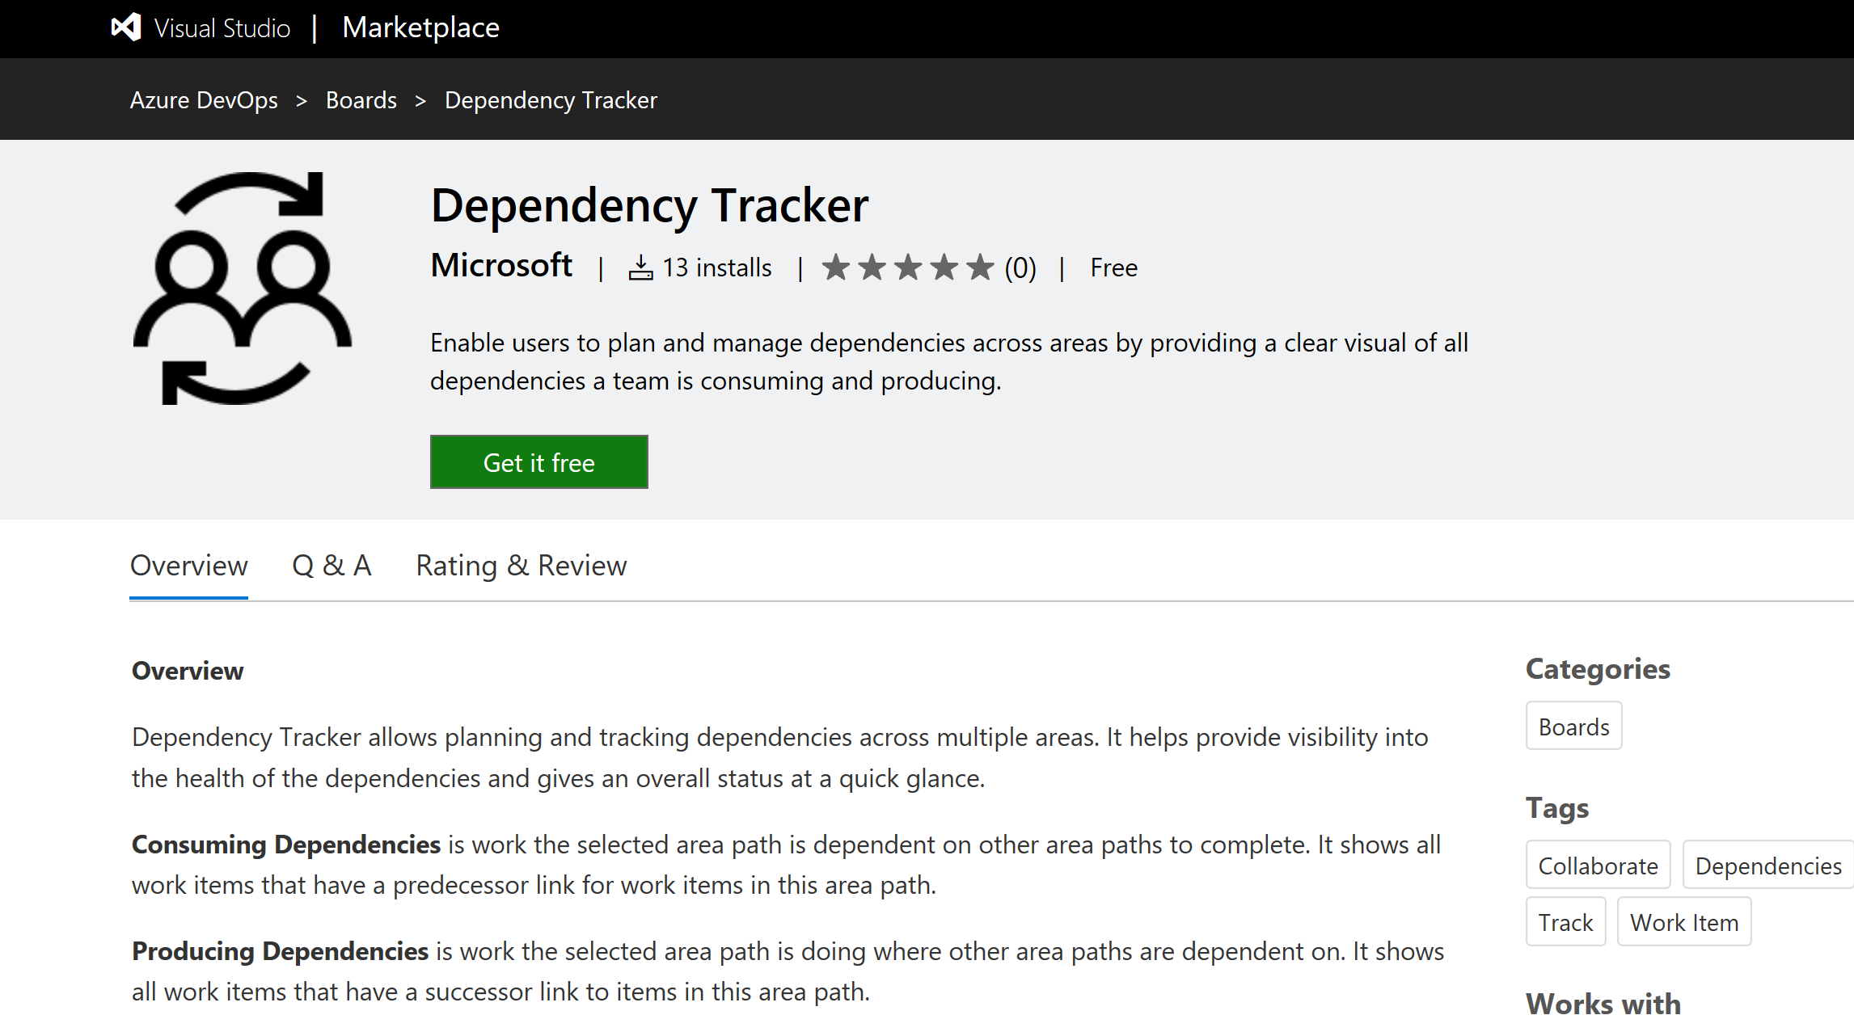
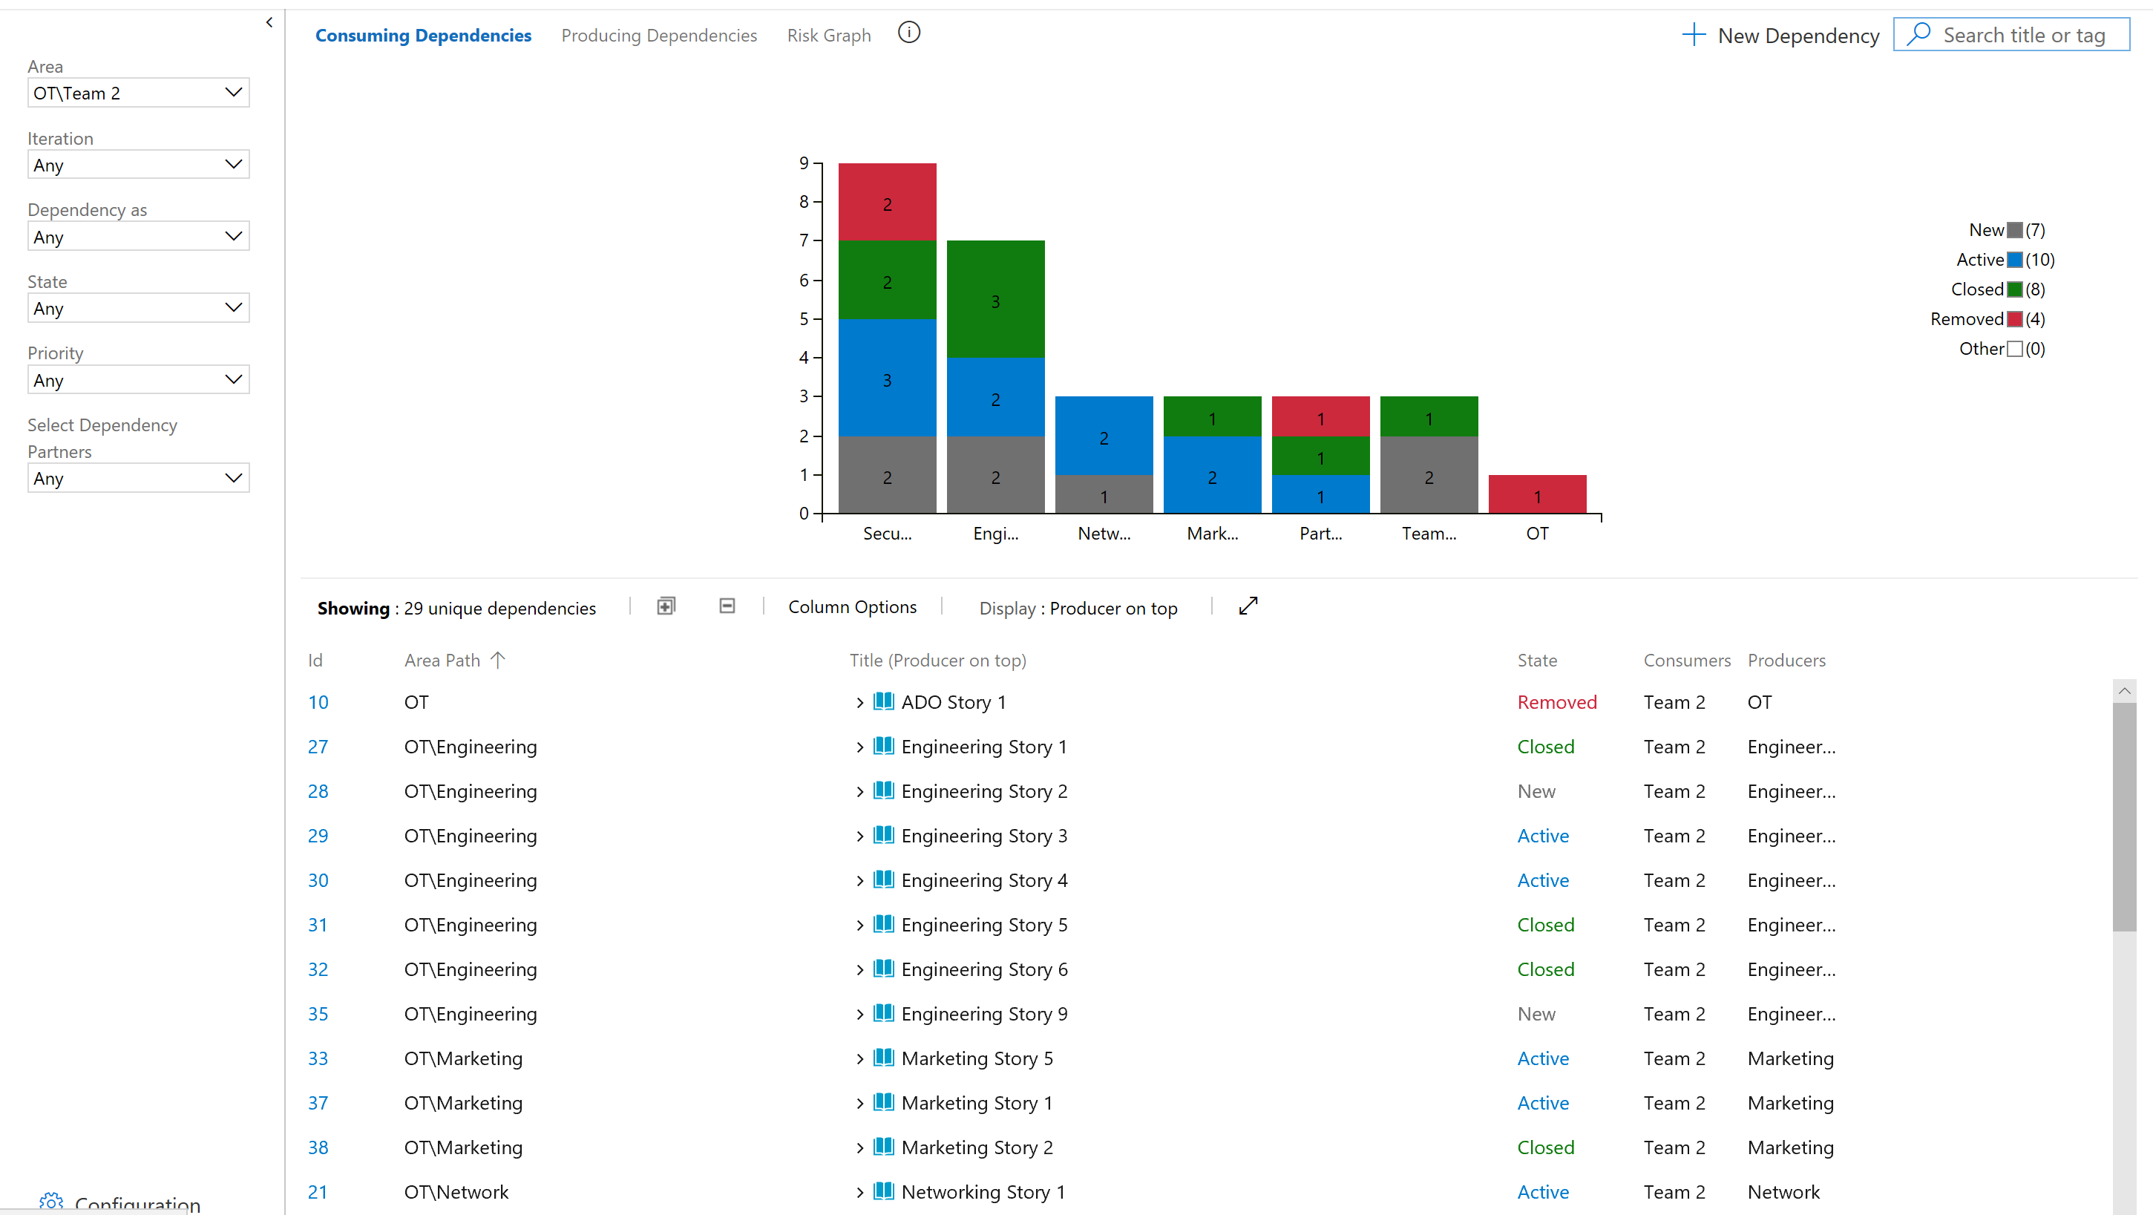
http://Aka.ms/DependencyTracker
DEPENDENCY TRACKER
Dependency Tracker allows planning and tracking dependencies across multiple areas. It helps provide visibility into the health of the dependencies and gives an overall status at a quick glance.

Slide 72
THANK YOU!
Jill Campbell jillhous@microsoft.com
Edward Thomson @ethomson ethomson@microsoft.com

Slide 73
Please evaluate this session
Your feedback is important to us!
Please evaluate this session through MyEvaluations on the mobile app
or website.
Download the app:
https://aka.ms/ignite.mobileApp
Go to the website: https://myignite.techcommunity.microsoft.com/evaluations

