Slide 2
Ship-it with Azure Pipelines and GitHub
BRK2214
Jamie Cool

Slide 3
Jamie Cool
jamiec@microsoft.com
➔
https://azure.com/devops

Slide 4
Introducing Azure DevOps
Azure Boards
Azure Pipelines
Azure Repos
Deliver value to your users faster using proven agile tools to plan, track, and discuss work across your teams.
Build, test, and deploy with CI/CD that works with any language, platform, and cloud. Connect to GitHub or any other Git provider and deploy continuously.
Get unlimited, cloud-hosted private Git repos and collaborate to build better code with pull requests and advanced file management.
Azure Test Plans
Azure Artifacts
➔
Test and ship with confidence using manual and exploratory testing tools.
Create, host, and share packages with your team, and add artifacts to your CI/CD pipelines with a single click.
https://azure.com/devops

Slide 5
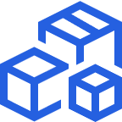
Azure Pipelines
Cloud-hosted pipelines for Linux, Windows and macOS.
Any language, any platform, any cloud
Build, test, and deploy Node.js, Python, Java, PHP, Ruby, C/C++, .NET, Android, and iOS apps. Run in parallel on Linux, macOS, and Windows. Deploy to Azure, AWS, GCP or on-premises
Extensible
Explore and implement a wide range of community-built build, test, and deployment tasks, along with hundreds of extensions from Slack to SonarCloud. Support for YAML, reporting and more
Containers and Kubernetes
Easily build and push images to container registries like Docker Hub and Azure Container Registry. Deploy containers to individual hosts or Kubernetes.
➔
https://azure.com/pipelines

Slide 6
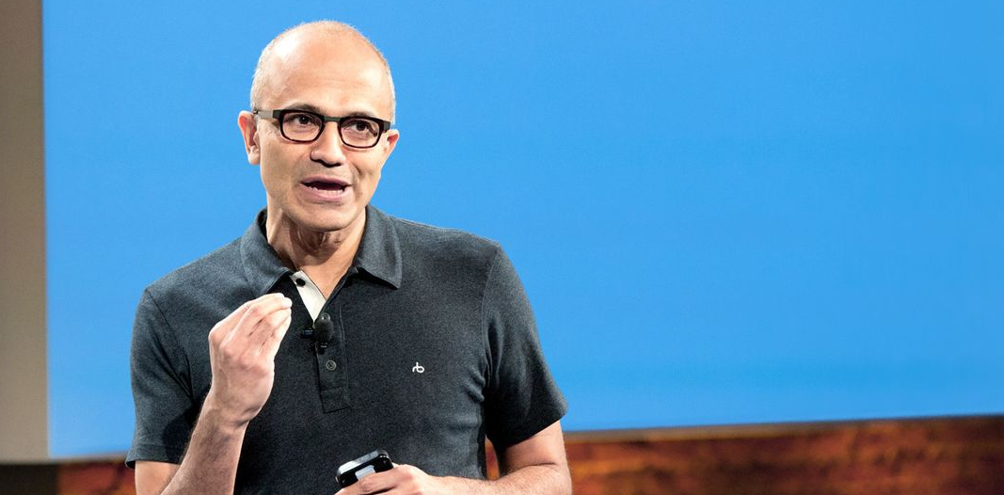
“Judge us by the actions we have taken in the recent past, our actions today and in the future”
—Satya Nadella, CEO Microsoft
2012
2018

Slide 7
Microsoft Open Source
2018
Visual Studio Code ranked #1 developer tool
Azure Service Fabric Open Sourced
Azure Sphere with Linux kernel
Intent to acquire GitHub announced
~5,000 Microsoft employees committing to open source projects on GitHub
Azure trending to 50% Linux
Microsoft continues as largest contributor to open source projects on GitHub
“Judge us by the actions we have taken in the recent past, our actions today and in the future”
—Satya Nadella, CEO Microsoft
2017
Microsoft Azure Kubernetes Service launched
Draft, Brigade, Kashti projects submitted to Kubernetes community
Microsoft joins Cloud Native Computing & Cloud Foundry Foundations
SQL 2017 on Linux
Windows source code moved to Git
Azure Databricks (Apache Spark) announced
2016
.NET Core 1.0
PowerShell Core
Windows Subsystem for Linux in Windows 10
Microsoft joins Linux Foundation
GitHub recognizes Microsoft as a top open source contributor
2015
Visual Studio Code released
HDInsight (Hadoop/ Ubuntu) announced
Microsoft jointly forms Node.js foundation
2014
Satya “Microsoft loves Linux”
Microsoft org on GitHub created
.NET Foundation created
2012
TypeScript released
Git support added to TFS and Visual Studio
2012
2014
2015
2016
2017
2018

Slide 8
Azure Pipelines
Microsoft Open Source
Free unlimited build minutes for public projects
Up to 10 free parallel jobs across Windows, Linux and macOS
➔
https://azure.com/pipelines

Slide 9
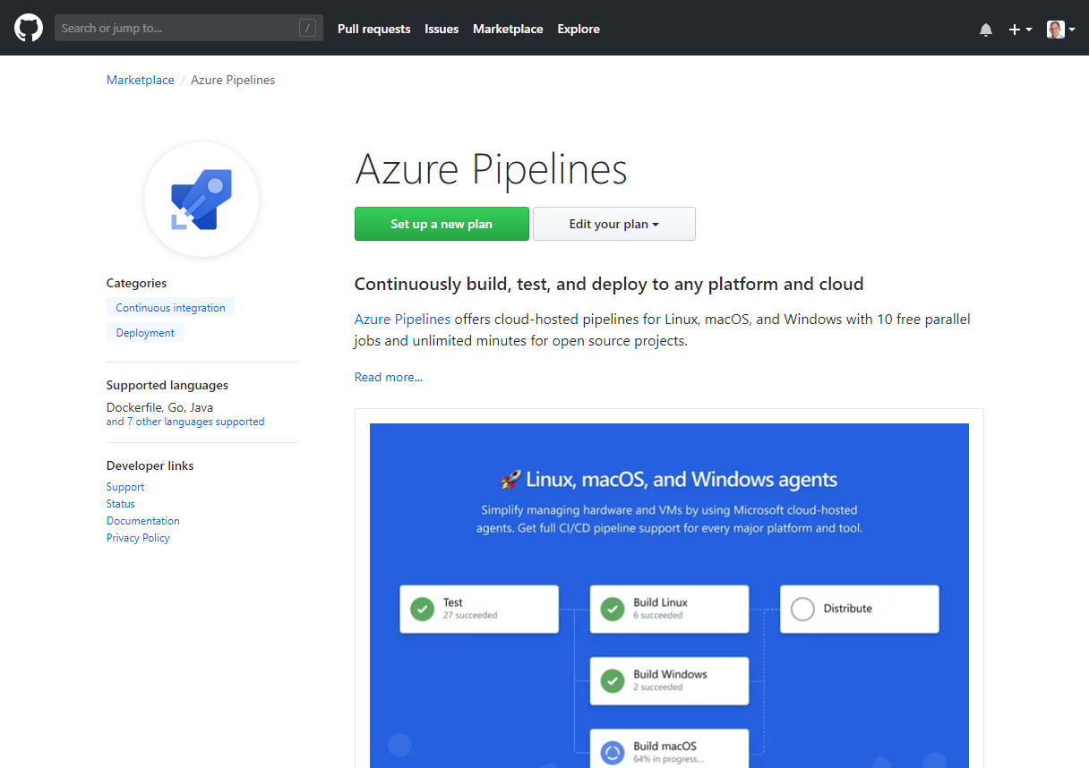
Integrated with GitHub
Azure Pipelines available now to any developer from the GitHub Marketplace

Slide 10
GitHub support for Azure Pipelines
#AzureDevOps
Demo
Jamie Cool

Slide 11
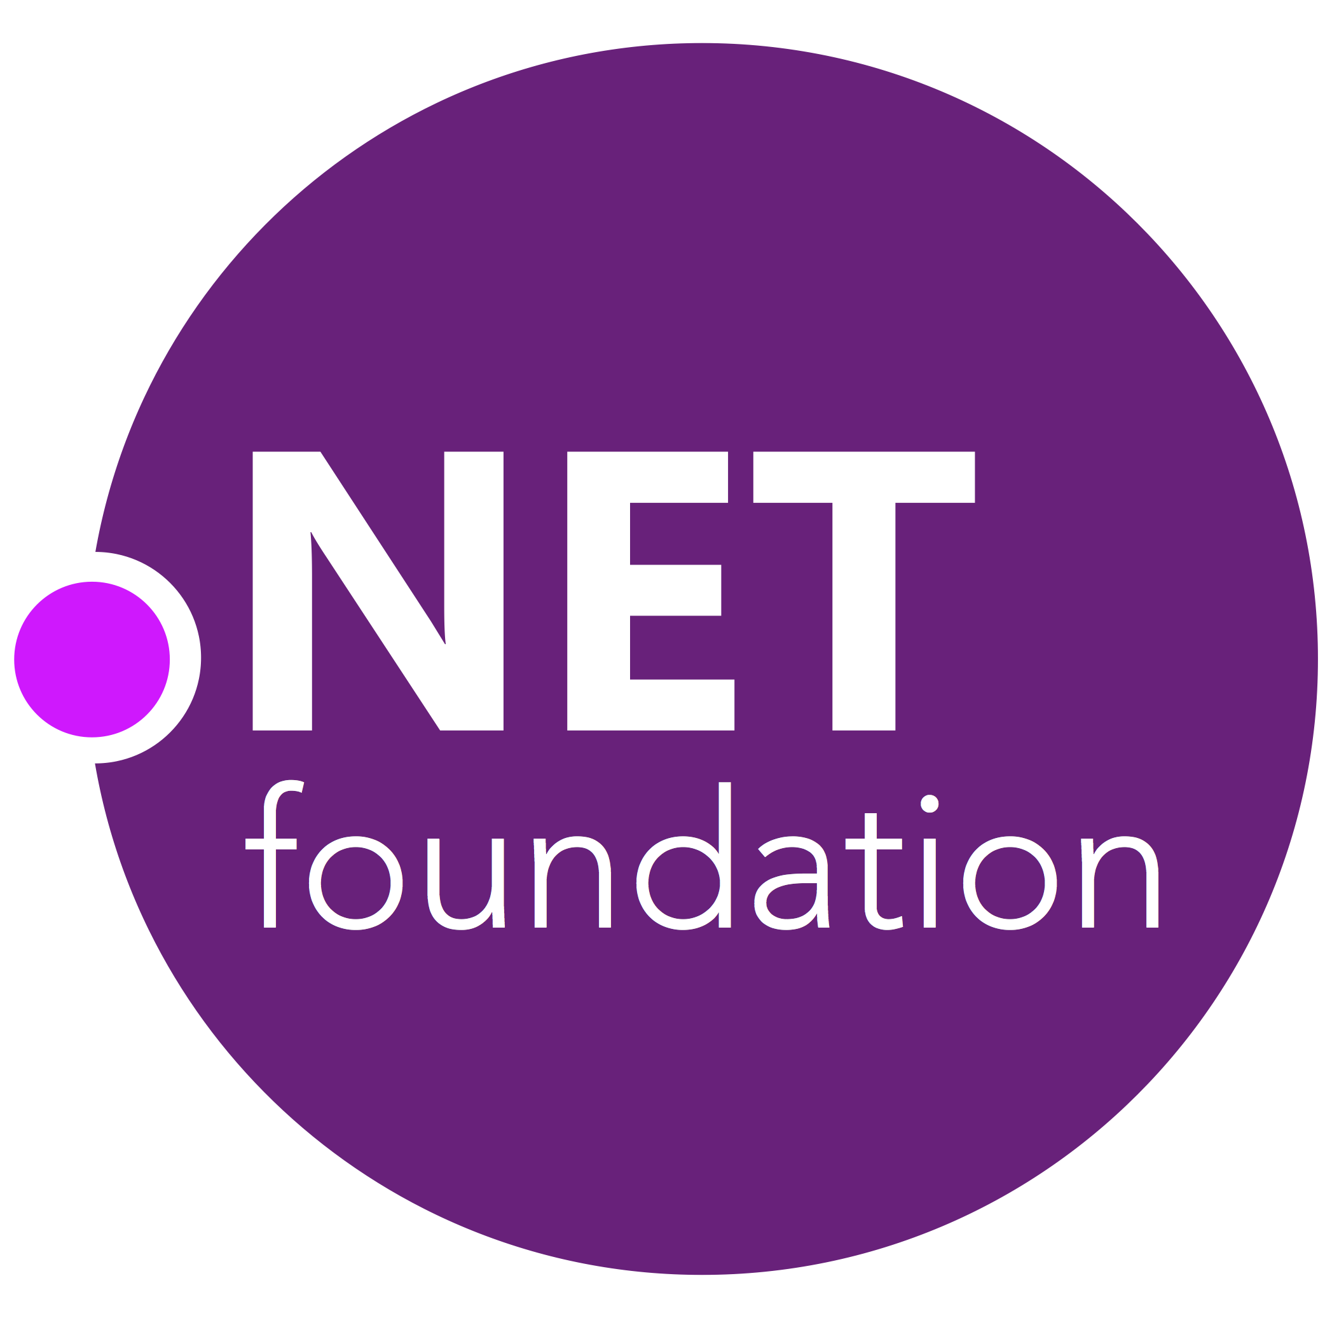
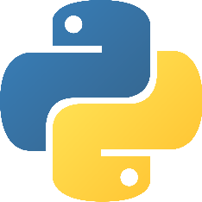
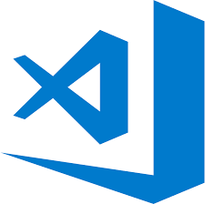
Early adopters
Open source projects already powered by Azure Pipelines

Slide 12
Open source projects using Azure DevOps
#AzureDevOps
Demo
Jamie Cool

Slide 13
Azure DevOps supports small teams to the largest enterprises
Instead of telling people to wait for 6 months for a new feature, we can give it to them in a few weeks…Our 2800 worldwide developers can use the same backlog, user stories and tests whether they’re on Windows or Linux… building for iOS or Android.
Speed is gained in moving to the PaaS offering of Azure DevOps. PaaS provides regularly released features and a future-proof capability, eliminating the need for Accenture to maintain infrastructure and go through upgrade cycles.
“
“
”
”
Microsoft made it really easy to break outside the silos… and tie the DevOps process into the fulfilment of business process. Without the tools that we have today, we would not be successful.
Branches sync 500 percent faster. Builds are 400 percent faster, with the typically six-hour process reduced to 90 minutes. We (now have) a highly streamlined process that operates with a few button clicks—and one-button deployment.
“
“
”
”

Slide 14
DevOps at Microsoft
Azure DevOps is the toolchain of choice for Microsoft internal engineering with over 90,000 internal users
➔
https://aka.ms/DevOpsAtMicrosoft
372k
Pull Requests per month
4.4m
Builds per month
5m
Work items viewed per day
78,000
Deployments per day
2m
Git commits per month
500m Test executions per day
500k
Work items updated per day
Data: Internal Microsoft engineering system activity, September 2018

Slide 15
Building & Deploying Azure DevOps with Azure DevOps
#AzureDevOps
Demo
Jamie Cool

Slide 16
Azure DevOps
Better together
Azure Boards
Azure Repos
Azure Pipelines
Azure Test Plans
Azure Artifacts
An end-to-end solution for organizations looking for an enterprise-grade toolchain
Fully Integrated with end to end traceability
Scalable to any team and project size
Highly available, multi region, hybrid cloud & on-prem
Customer Support
Consistent admin and access control
➔
https://azure.com/devops

Slide 17
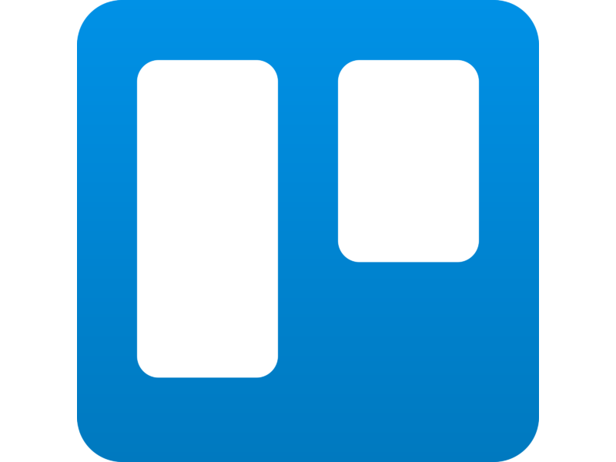
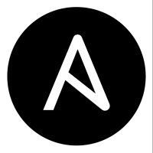
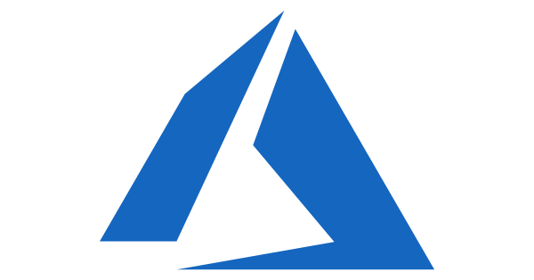
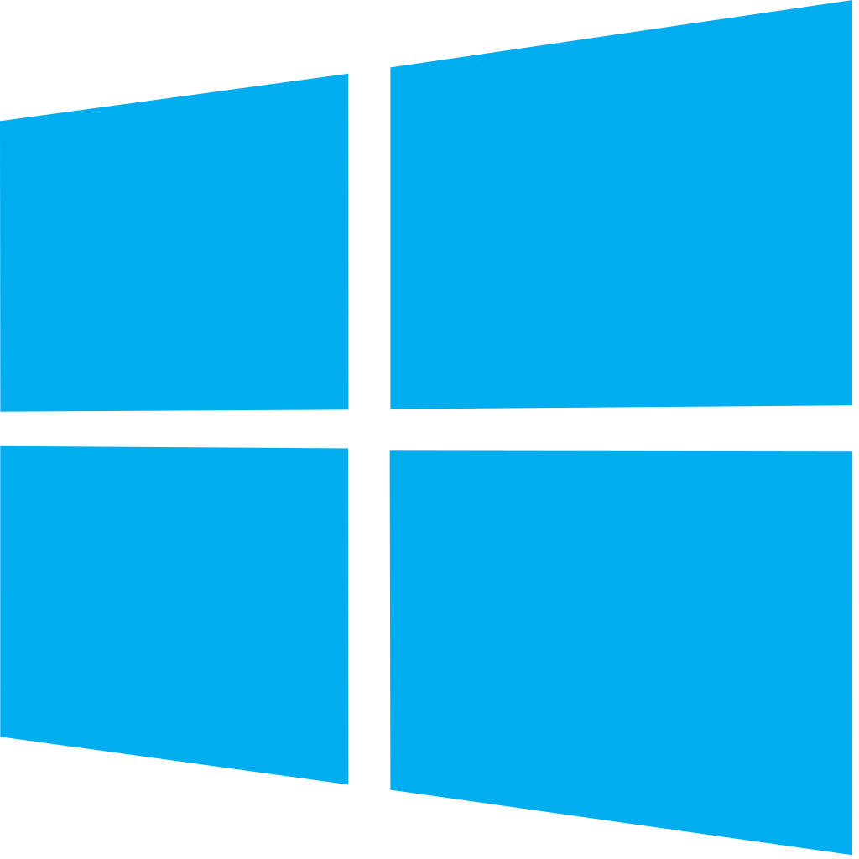
Azure DevOps: Choose what you love
Your tools, languages, and clouds
Azure DevOps lets developers choose the tools and languages that are right for them
Mix and match to create workflows with tools from Microsoft, open source or your favorite 3rd party tools
Target any cloud, on-prem or both and deploy to the servers you need

Slide 18
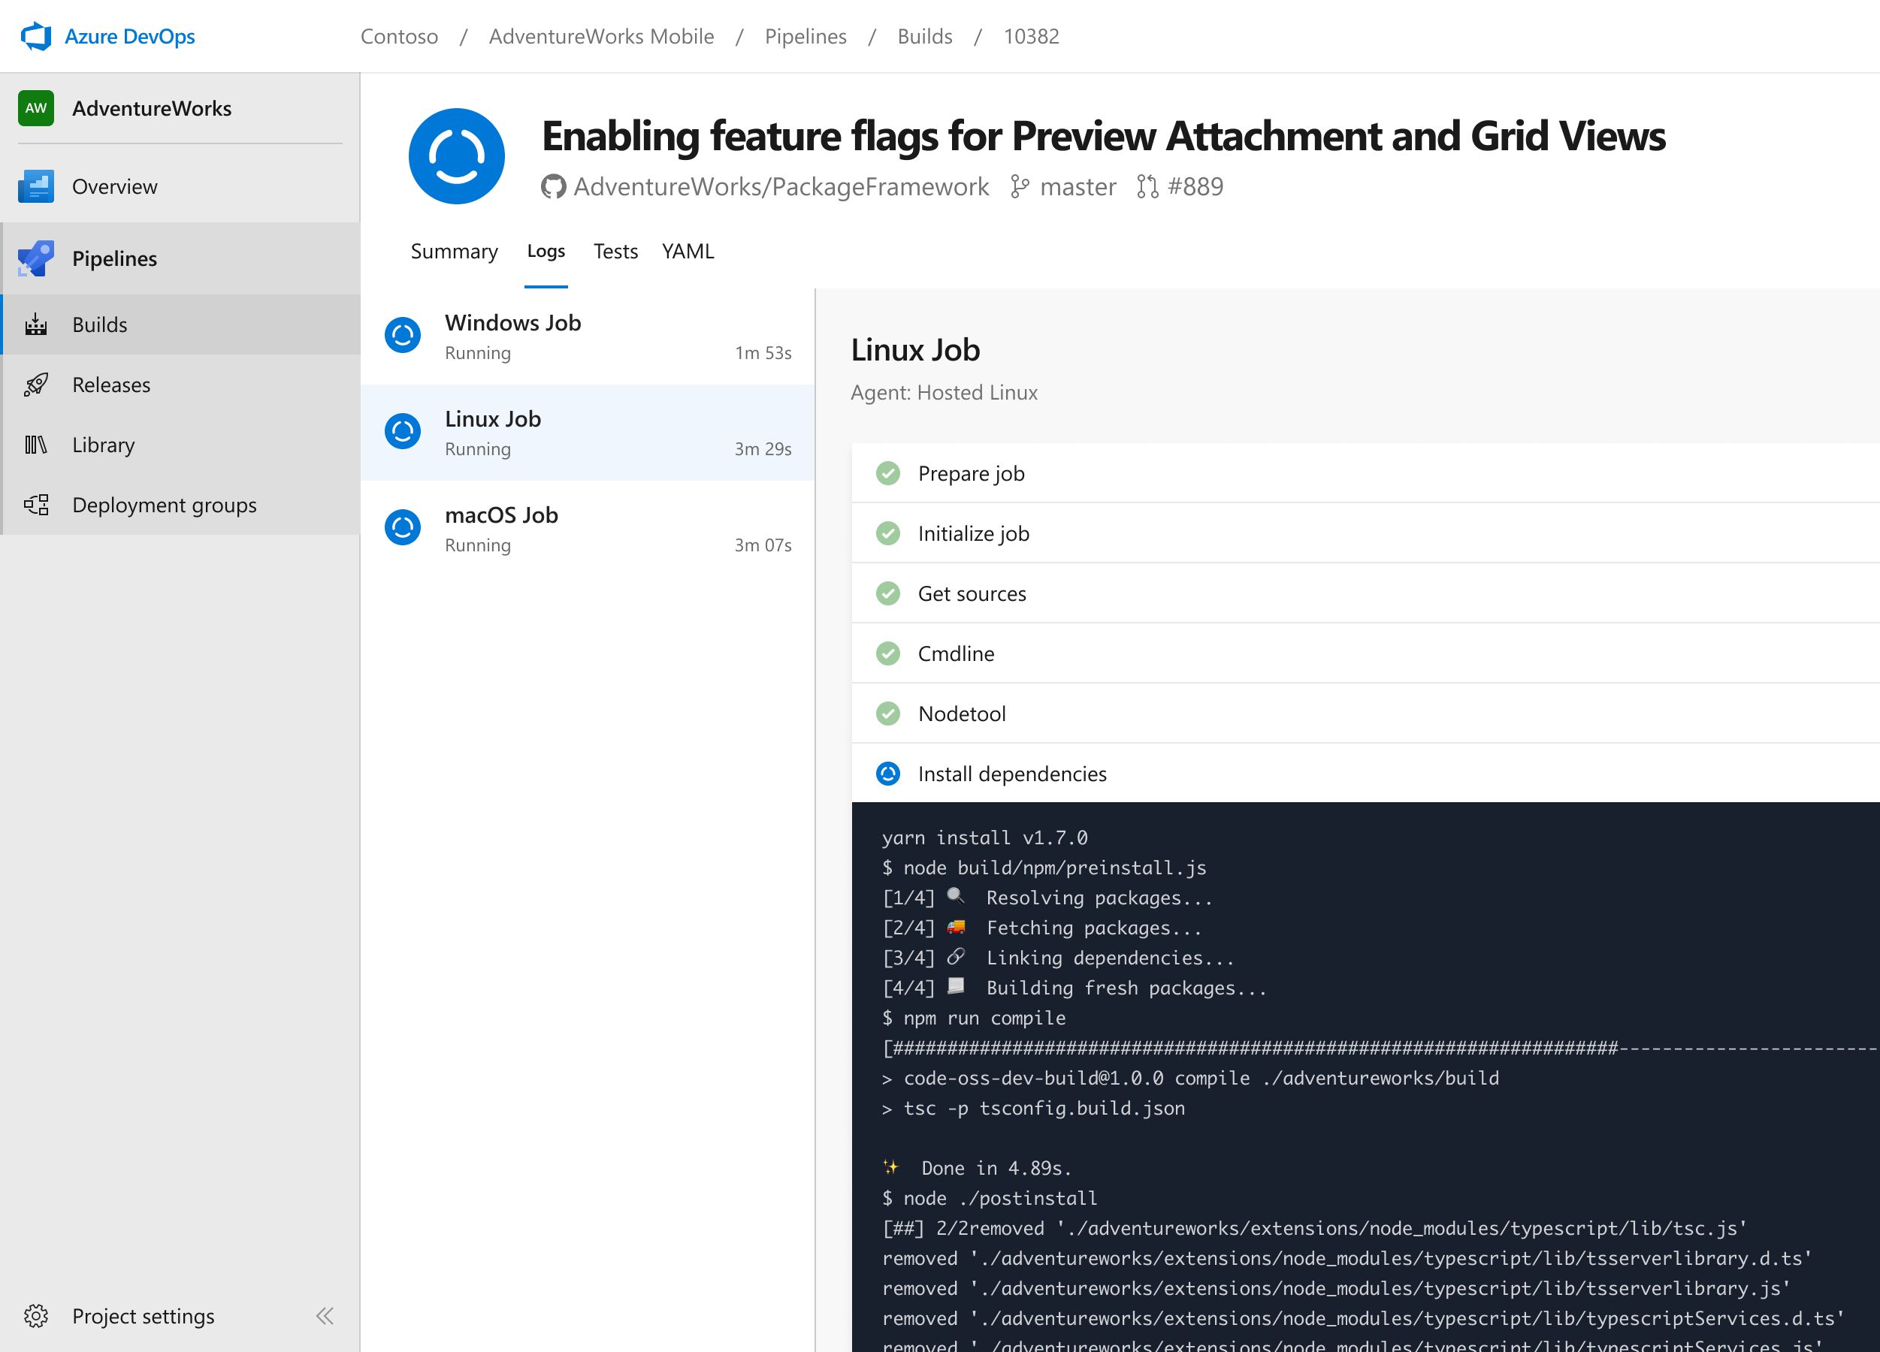
Azure Pipelines
Cloud-hosted pipelines for Linux, Windows and macOS, with unlimited minutes for open source
Any language, any platform, any cloud
Build, test, and deploy Node.js, Python, Java, PHP, Ruby, C/C++, .NET, Android, and iOS apps. Run in parallel on Linux, macOS, and Windows. Deploy to Azure, AWS, GCP or on-premises
Extensible
Explore and implement a wide range of community-built build, test, and deployment tasks, along with hundreds of extensions from Slack to SonarCloud. Support for YAML, reporting and more
Containers and Kubernetes
Easily build and push images to container registries like Docker Hub and Azure Container Registry. Deploy containers to individual hosts or Kubernetes.
Best-in-class for open source
Ensure fast continuous integration/continuous delivery (CI/CD) pipelines for every open source project. Get unlimited build minutes for all open source projects with up to 10 free parallel jobs across Linux, macOS and Windows
➔
https://azure.com/pipelines

Slide 19
Azure DevOps
Plan smarter, collaborate better, and ship faster with a set of modern dev services
Any developer, any platform, any cloud. Full support for hybrid cloud, on-premises & containers.
Use all the Azure DevOps services or choose just what you need to complement your existing workflows
Best in class builds for open source. Free unlimited build minutes for public projects and up to 10 free concurrent jobs across Windows, Linux and macOS
Get started for free for small teams, scales to support the largest enterprises
Azure Boards
Azure Repos
Azure Pipelines
Azure Test Plans
Azure Artifacts
Start free today
➔
https://azure.com/devops

Slide 20
Thank you!
Jamie Cool
jamiec@microsoft.com
➔
https://azure.com/devops

Slide 21
Please evaluate this session Your feedback is important to us!
Please evaluate this session through MyEvaluations on the mobile app or website.
Download the app: https://aka.ms/ignite.mobileApp
Go to the website: https://myignite.techcommunity.microsoft.com/evaluations

