Slide 2
Get apps out the door faster and easier with the Microsoft identity platform
BRK2369
Saeed Akhter - Principal Lead Program Manager

Slide 3
Agenda
Microsoft identity platform
Simplifying the app registration experience
Microsoft Authentication Libraries
Deep dive on browser-based JavaScript applications
How you can update at your own pace

Slide 4
Our vision
To be the BEST identity developer platform
Reach your target audience
Security and
trust
Ready for your
business
Fast and simple integration

Slide 5

Our vision
Reach your target audience
Sign in any identity, on premise or in the cloud
employees, students, users
Invite business partners to sign in and collaborate
Reach customers with fully customizable experiences
HYBRID
ON PREMISES
CLOUD
Organizations
Individuals

Slide 6
Our vision
Security and trust
Advanced identity and data protection
detection
mitigation
prevention
control
IT is in control of access to user and organizational data
consent framework

Slide 7


Security and trust
Extend security benefits that come with Azure AD to your application
Conditions
Controls
10TB
Allow access
Users
Session
Risk
Machine
learning
3
Devices
Require MFA
On-premises apps
Force
password reset
Real time
Evaluation
Engine
******
Location
Deny access
Policies
Effective
policy
Web apps
Apps
Limit access

Slide 8

Security and trust
Consent model
IT ADMIN
APP DEVELOPER
END USER

Slide 9
Our vision
Ready for your business
Integrates with of your existing systems, open standards
Worldwide global and sovereign cloud presence
Unlock innovation with data that powers your business

Slide 10

Ready for your business
Every Office 365 and Microsoft Azure customer uses Azure Active Directory
1.1B
653 K
8 T
identities
in Azure AD
3rd party apps
in Azure AD
resources in Microsoft Graph
400 M
8 B
90 %
Outlook.com
active users
daily Azure AD
authentications
of Fortune 500 data in Microsoft Graph
Sep 2018

Slide 11
Our vision
Fast and simple integration
One place to get started
Sample code that gives me instant gratification
For my platform and language of choice
Using the tools that I love

Slide 12
Microsoft identity platform
(evolution of Azure AD for Developers)

Slide 13
Cleaning up our mess
App registration
portal.azure.com
apps.dev.microsoft.com
portal.azure.com
(Azure AD B2C blade)
Client SDK
ADAL
MSAL
v1 endpoint
v2 endpoint
Endpoint
v1 tokens
v2 tokens
ADFS
Azure AD
MSA
Azure AD B2C
Your target audience
HYBRID
ON-PREMISES
CLOUD

Slide 14
Fast and simple integration
Simplifying the developer platform
App registration
portal.azure.com
Client SDK
ADAL
MSAL
v1 endpoint
v2 endpoint
Endpoint
v1 tokens
v1 tokens or v2 tokens
ADFS
Azure AD
MSA
Azure AD B2C
Your target audience
HYBRID
ON-PREMISES
CLOUD

Slide 15
Azure App Portal Demo
Registering and managing apps that use the Microsoft identity platform

Slide 16
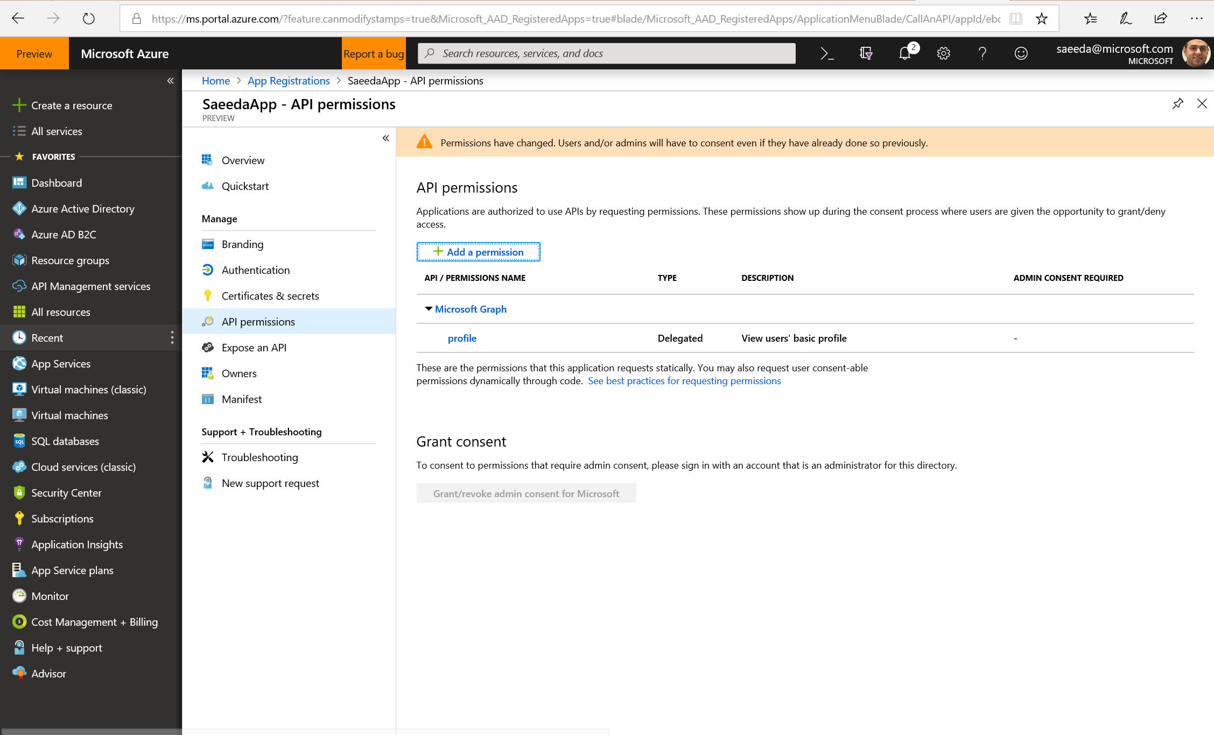
Fast and Simple Integration
Releasing to Public Preview early November!
Register, update and manage all apps in one place
Improved usability
Sign up to be notified!
https://aka.ms/IdentityPlatformPortal

Slide 17
Fast and simple integration
Authentication libraries
Secure access to users and data made simple
  Microsoft’s world (Microsoft Graph, other APIs)
  Your own APIs
MSAL - best in class auth libs
  Built for v2 endpoint, reach any audience
  Follows Microsoft Security Development Lifecycle
Update at your own pace
  ADAL based apps continue to work
  Portfolio of ADAL and MSAL apps get Single Sign On
MOBILE APP
CLIENT SDK

Slide 18







Microsoft Authentication Libraries (MSAL)
On track for GA in early spring
Preview updates every 4-6 weeks
Bringing MSAL to same feature richness as ADAL
PREVIEW
PREVIEW
PREVIEW
PREVIEW
JavaScript
Angular
.NET
UWP
PREVIEW
PREVIEW
PREVIEW
Android
iOS
Xamarin

Slide 19
Microsoft Authentication Libraries (MSAL)
Done: Get a v1 token and call existing APIs
Done: Maintain sign in state when updating from ADAL to MSAL
Done: Portfolio of ADAL and MSAL apps get Single Sign On
PREVIEW
PREVIEW
PREVIEW
PREVIEW
JavaScript
Angular
.NET
UWP
PREVIEW
PREVIEW
PREVIEW
Android
iOS
Xamarin

Slide 20
Microsoft Authentication Libraries (MSAL)
Done: MSAL.js is feature complete vs ADAL.js
Integrate now and give us your feedback – http://aka.ms/msalsurvey
PREVIEW
PREVIEW
PREVIEW
PREVIEW
JavaScript
Angular
.NET
UWP
PREVIEW
PREVIEW
PREVIEW
Android
iOS
Xamarin

Slide 21
Microsoft Authentication Libraries (MSAL)
Done: Works great with ASP.NET for calling resource API
PREVIEW
PREVIEW
PREVIEW
PREVIEW
JavaScript
Angular
.NET
UWP
PREVIEW
PREVIEW
PREVIEW
Android
iOS
Xamarin

Slide 22
Microsoft Authentication Libraries (MSAL)
Up next: raw username/password
Up next: Windows integrated authentication
Up next: device code flow (bot framework)
PREVIEW
PREVIEW
PREVIEW
PREVIEW
JavaScript
Angular
.NET
UWP
PREVIEW
PREVIEW
PREVIEW
Android
iOS
Xamarin

Slide 23
Microsoft Authentication Libraries (MSAL)
Done: Embedded and default browser support
PREVIEW
PREVIEW
PREVIEW
PREVIEW
JavaScript
Angular
.NET
UWP
PREVIEW
PREVIEW
PREVIEW
Android
iOS
Xamarin

Slide 24
Microsoft Authentication Libraries (MSAL)
Up Next: Authenticator app support
PREVIEW
PREVIEW
PREVIEW
PREVIEW
JavaScript
Angular
.NET
UWP
PREVIEW
PREVIEW
PREVIEW
Android
iOS
Xamarin

Slide 25


Deep-dive browser-based JavaScript apps
WEB APP
AZURE AD
CLIENT SDK
BROWSER
HTML
Microsoft Graph

Slide 26
MSAL.js Demo
PREVIEW
JavaScript
Use Microsoft Identities in your browser-based app

Slide 27

Single Sign On ADAL.NET with MSAL.NET Demo
ADAL v3
ADAL v4
MSAL
CACHE ADALv3
BINARY
UNIFIED CACHE
JSON

Slide 28
MSAL.NET Demo
PREVIEW
.NET
Single Sign On across ADAL and MSAL Desktop apps

Slide 29
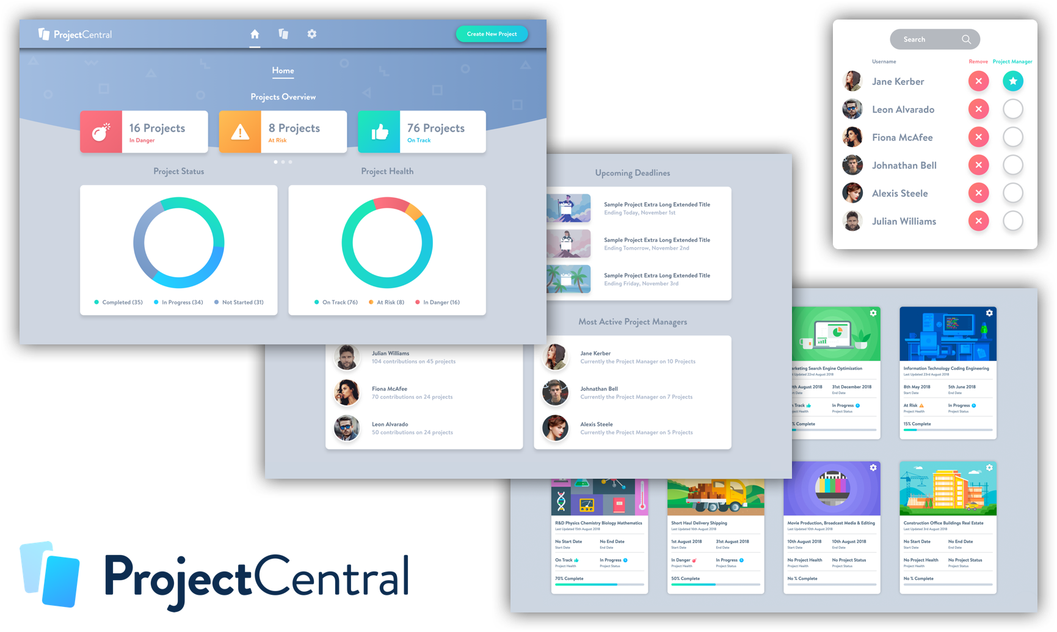
ProjectCentral
Donal McWeeney

Slide 30
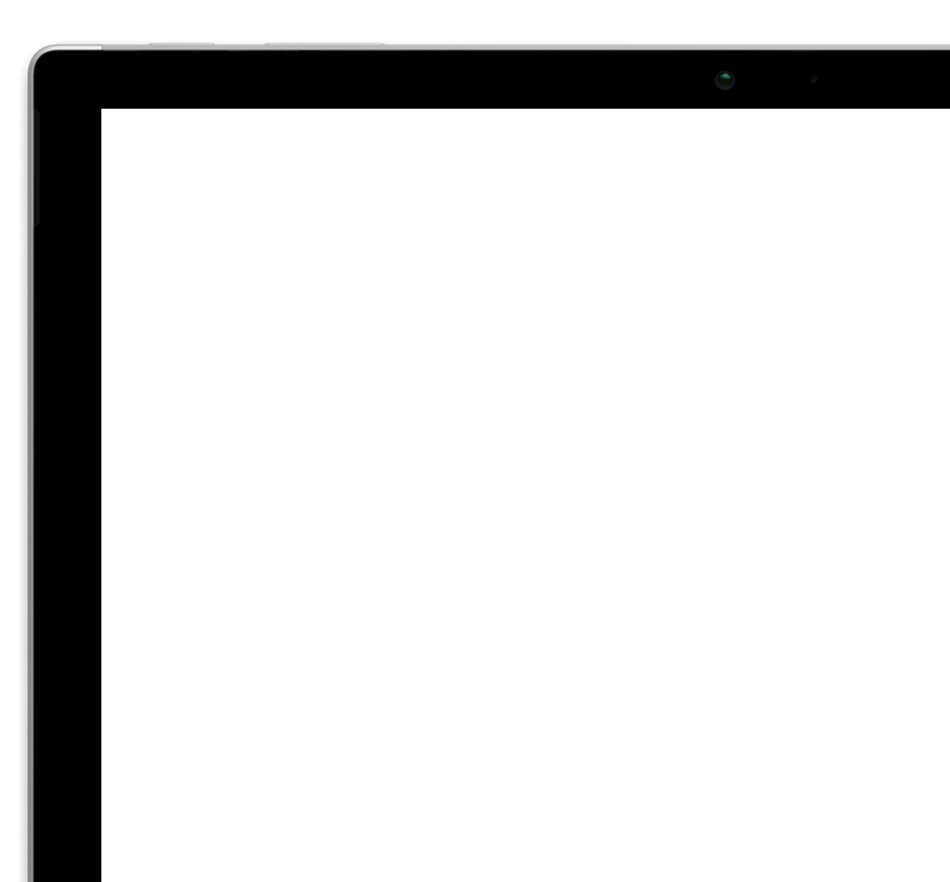
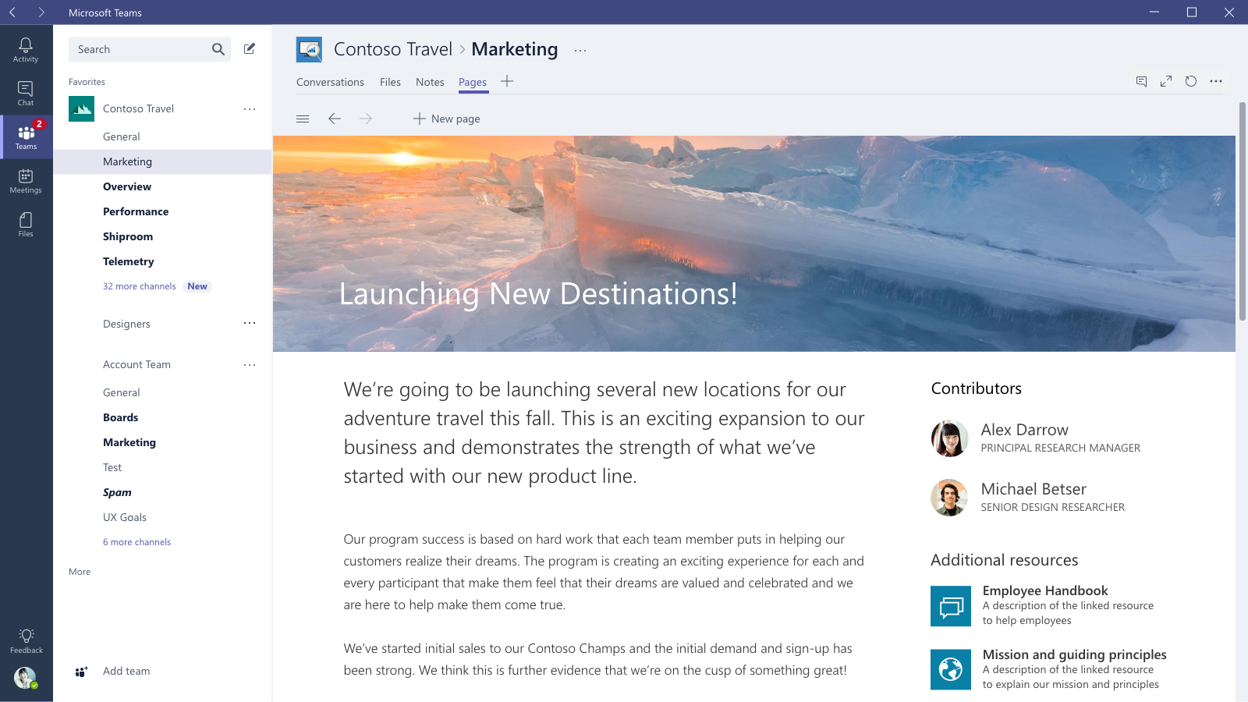
Microsoft Teams
MSAL.js in pre-production testing today!

Slide 31
Microsoft identity platform
Reach your target audience
Security and Trust
Ready for your business
Fast and simple integration
Update your apps at your own pace

Slide 32
Attend our sessions and learn more about our
Identity Platform and the Microsoft Graph
Code | Title | Day | Location | Time | Focus
TH2079 | Registering and managing apps through Microsoft Azure Portal and Microsoft Graph API | Tuesday | Expo Theater #9 | 11:55AM-12:15PM | Auth
BRK2369 | Get apps out the door faster and easier: Microsoft's unified programming model for authentication, app management, and securely accessing APIs. | Tuesday | OCCC W224 AB | 12:30PM-1:45PM | Auth
TH2080 | Build smarter communications with Microsoft Graph and AI | Tuesday | Expo Theater #11 | 2:50PM-3:10PM | Microsoft Graph
TH2081 | Single sign-on best practices for Azure Active Directory and Microsoft Accounts | Wednesday | Expo Theater #12 | 12:30AM-12:50PM | Auth
BRK2266 | Streamlining your business processes using Microsoft Graph | Wednesday | OCCC W304 A-D | 4:30PM-5:15PM | Microsoft Graph
BRK2265 | Architecting your app’s access and security with identity as the control plane | Thursday | OCCC W304 A-D | 10:15AM-11:00AM | Auth
BRK2404 | Build compelling experiences by bringing your organization's data together with Microsoft Graph | Friday | Hyatt Regency Plaza International I-K | 10:15PM-11:00PM | Microsoft Graph
TH2159 | How to perform large scale operations efficiently using Microsoft Graph | Friday | Hyatt Building Theater | 12:00PM-12:20PM | Microsoft Graph
LAB | Simplify Sign in experience for work and Personal accounts on SPA and call APIs | Anytime | Immersion Zone | Anytime | Auth + Microsoft Graph

Slide 33
Get Started
Get started at:
aka.ms/identityplatform
Make a pull request and win a shirt!
aka.ms/msidhacktoberfest
Ask a question:
aka.ms/MsIdStackOverflow
Support
Get help at:
aka.ms/identityplatformsupport
Take our survey and give us feedback:
http://aka.ms/msalsurvey

Slide 34
Please evaluate this session
Your feedback is important to us!
Please evaluate this session through MyEvaluations on the mobile app
or website.
Download the app:
https://aka.ms/ignite.mobileApp
Go to the website: https://myignite.techcommunity.microsoft.com/evaluations

