Slide 2
Container DevOps with Microsoft Azure
BRK3192
Jessica Deen

Slide 3

Hello!
I am Jessica Deen
I am here because I love technology and community.
I focus heavily on Linux, OSS, DevOps and Containers.
I love Disney and CrossFit/Fitness.
You can find me at @jldeen on GitHub, Twitter, and Instagram.

Slide 4
Attention: Disclaimer
The next 75 minutes will NOT make you an expert, but it will:
  Get you thinking
  Show you what’s possible
  Give you some sample code for you to get started on your own time

Slide 5
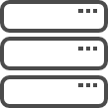

GOING DIGITAL
1 million/hour
new devices coming online
by 2020
12 years
average age of S&P 500 corporations
by 2020
60% computing
in the public cloud by 2025

Slide 6
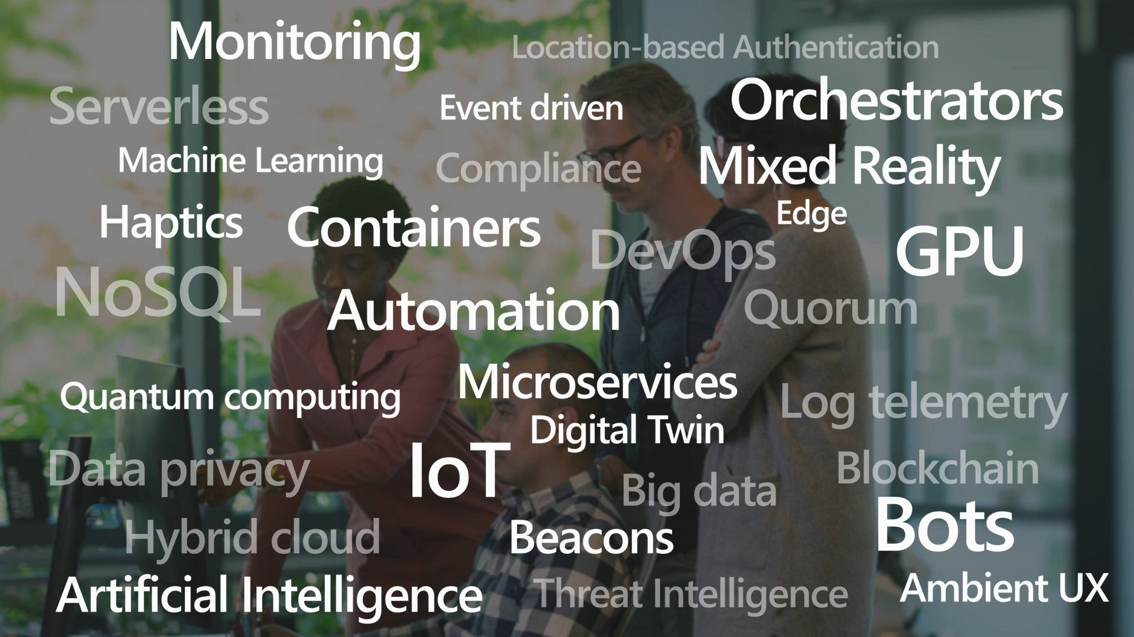

Slide 7
What we hear from developers
I need to create applications at a competitive rate without worrying about IT
New applications run smoothly on my machine but malfunction on traditional IT servers
My productivity and application innovation become suspended when I have to wait on IT

Slide 8
What we hear from IT
I need to manage servers and maintain compliance with little disruption
I’m unsure of how to integrate unfamiliar applications, and I require help from developers
I’m unable to focus on both server protection and application compliance

Slide 9
IT stress points
Security
threats
Datacenter efficiency
Supporting innovation

Slide 10
Cloud is a new way to think about a datacenter
  Traditional model
  Dedicated infrastructure for each application
  Purpose-built hardware
  Distinct infrastructure and operations teams
  Customized processes and configurations
  Cloud model
  Loosely coupled apps and micro-services
  Industry-standard hardware
  Service-focused DevOps teams
  Standardized processes and configurations
Servers
Services

Slide 11

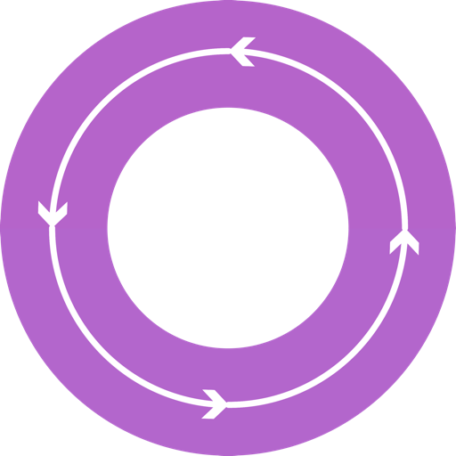



DevOps: the three stage conversation
DEV
OPS
1
People
2
Process
3
Products

Slide 12
What is DevOps?
People. Process. Products.
Build& Test
Deploy
DevOps is the union of people, process, and products to enable continuous delivery of value to your end users.
“
Continuous
Delivery
Develop
Operate
”
Plan
&
Track
Monitor
&
Learn

Slide 13


High Performance DevOps Companies Achieve…
46x Deployment
Frequency
2,555x Faster Lead
Time For Changes
Faster
Time to Market
DevOps
$
Increased
Revenue
7x Lower Change
Failure Rate
2,604x Faster Mean
Time to Recover
Source: 2018 Accelerate: State of DevOps: Strategies for a New Economy." N. Forsgren, J. Humble, G. Kim. DevOps Research and Assessment (DORA)

Slide 14
Key DevOps Practices
Infrastructure as Code
Continuous Integration
Continuous Deployment
Automated Testing
Release Management
Performance Monitoring
Availability Monitoring
Load Testing & Auto Scale
Automated Recovery (Rollback & Roll Forward)

Slide 15
Why Containers?
Enable ‘write-once, run-anywhere’ apps
Enables microservice architectures
Great for dev/test of apps and services
Production realism
Growing Developer Community
DevOps
Developers
Portability, Portability, Portability
Standardized development, QA, and prod environments
Abstract differences in OS distributions and underlying infrastructure
Higher compute density
Easily scale-up and scale-down in response to changing business needs
Operations

Slide 16
What is a container?
Containers = operating system virtualization
Traditional virtual machines = hardware virtualization
OS
Application
VM
VM
VM
Applications
Container
Container
Container
App
App
App
Kernel
OS
OS
OS
OS
Hardware
Hardware
Windows Server containers: maximum speed and density
Hyper-V containers: isolation plus performance
Container
Container
Container
Container
Container
Container
Kernel
Kernel
Kernel
Hardware
Hyper-V

Slide 17
What is a container?
Not a real thing. An application delivery mechanism with
process isolation based on several Linux kernel features.
Namespaces
(what a process can see)
Cgroups
(what a process can use)
PID
Mount
Network
UTS
IPC
User
Cgroup
Memory
CPU
Blkio
Cpuacct
Cpuset
Devices
Net_prio
Freezer

Slide 18
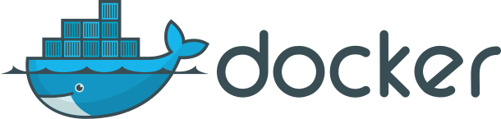
What is ?
An open source container runtime
Mac, Windows & Linux support
Command line tool
“Dockerfile” file format for building container images
The Docker image format with layered filesystem

Slide 19
Docker Layered Filesystem
Notes:
Add in graphic from Codefresh layer example -

Slide 20
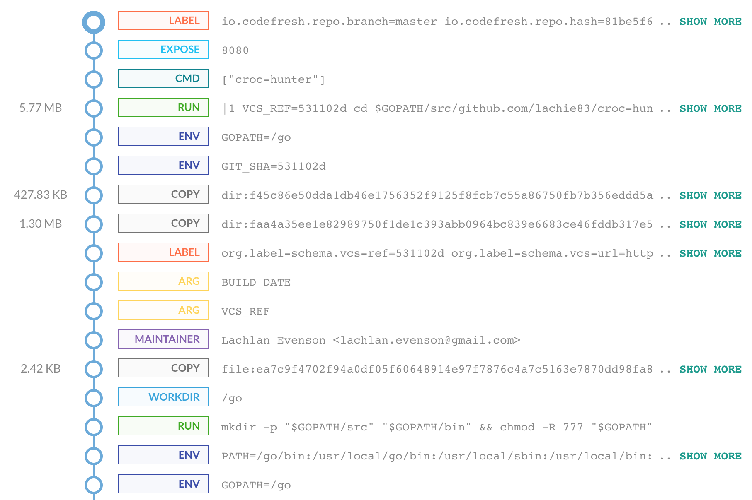
Docker Layered Filesystem
Notes:
Add in graphic from Codefresh layer example -

Slide 21
Virtualization versus containerization
Virtualization
Containerization
Virtual machine
Container
Application XYZ
Application
App dependencies
Dependencies
Guest OS
C
C
C
C
C
VM
VM
VM
VM
VM
VM
Dependency 1
Dependency 2
Hypervisor 2
Docker Engine
Hypervisor 1
Host OS
Host OS
Hardware
Hardware
Hardware
Type 1
Type 2

Slide 22
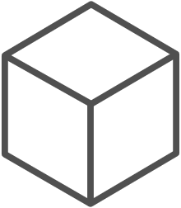
The container advantage
Fast
iteration
Agile
delivery
Immutability
Cost
savings
Efficient deployment
Elastic bursting
For developers
For IT

Slide 23
Demo - Containers

Slide 24
Container Orchestration

Slide 25
The elements of orchestration
Scheduling
Affinity/anti-affinity
Health monitoring
Failover
Scaling
Networking
Service discovery
Coordinated app upgrades

Slide 26
Kubernetes: the de-facto orchestrator
Portable
Public, private, hybrid, multi-cloud
Extensible
Modular, pluggable, hookable, composable
Self-healing
Auto-placement, auto-restart, auto-replication, auto-scaling

Slide 27
Kubernetes: empowering you to do more
Deploy your applications quickly and predictably
Scale your applications on the fly
Roll out
new features seamlessly
Limit hardware usage to required resources only

Slide 28
Container Orchestration: Kubernetes

Slide 29
What is Kubernetes?
Open source container orchestrator that automates deployment, scaling, and management of applications
Features include:
  Automatic bin-packing
  Self-healing
  Horizontal scaling
  Service discovery and load balancing
  Automated rollouts and rollbacks
  Secret and configuration management
  Storage orchestration
  Batch execution

Slide 30
Kubernetes - Agility
Container Orchestrator
Containers
Servers

Slide 31
Kubernetes - Agility
Container Orchestrator
Containers
Servers

Slide 32
Kubernetes - Scalability
Container Orchestrator
Containers
Servers

Slide 33
Kubernetes - Scalability
Container Orchestrator
Containers
Servers

Slide 34
Kubernetes - Scalability
Container Orchestrator
Containers
Servers

Slide 35
Kubernetes - Reliability
Container Orchestrator
Containers
Servers

Slide 36
Azure Container Service (AKS)

Slide 37
Your Kubernetes cluster, managed by Azure

Slide 38
Why AKS?
Easy to use
  Fastest path to Kubernetes on Azure
  Up and running with 3 simple commands
Easy to manage
  Automated upgrades and patching
  Easily scale the cluster up and down
  Self-healing control plane
Uses Open APIs
  100% upstream Kubernetes

Slide 39
Getting Started with AKS
$ az aks create -g myResourceGroup -n myCluster --generate-ssh-keys
\ Running ..
$ az aks install-cli
Downloading client to /usr/local/bin/kubectl ..
$ az aks get-credentials -g myResourceGroup -n myCluster
Merged "myCluster" as current context ..
$ kubectl get nodes
NAME STATUS AGE VERSION
aks-mycluster-36851231-0 Ready 4m v1.8.1
aks-mycluster-36851231-1 Ready 4m v1.8.1
aks-mycluster-36851231-2 Ready 4m v1.8.1

Slide 40
Managing an AKS cluster
$ az aks list –o table
Name Location ResourceGroup KubernetesRelease ProvisioningState
------------------ ---------- -------------- ------------------- -------------------
myCluster westus2 myResourceGroup 1.7.7 Succeeded
$ az aks upgrade -g myResourceGroup -n myCluster –-kubernetes-version 1.8.1
\ Running ..
$ kubectl get nodes
NAME STATUS AGE VERSION
aks-mycluster-36851231-0 Ready 12m v1.8.1
aks-mycluster-36851231-1 Ready 8m v1.8.1
aks-mycluster-36851231-2 Ready 3m v1.8.1
$ az aks scale -g myResourceGroup -n myCluster --agent-count 10
\ Running ..

Slide 41
Kubernetes without AKS

Slide 42
Kubernetes with AKS

Slide 43
Demo – Azure DevOps Release

Slide 44

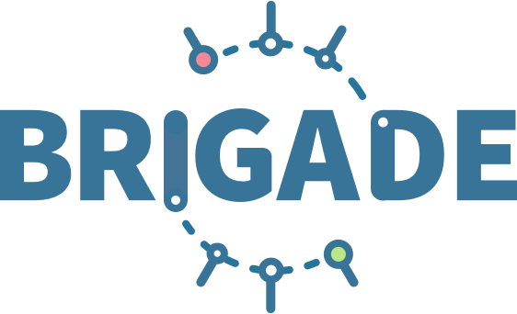


Release automation tools
Azure Container Service (AKS)
Simplifying the Kubernetes experience
Azure Container Instances (ACI)
Azure Container Registry
Open Service
Broker API (OSBA)
Streamlined Kubernetes development
The package manager for Kubernetes
Event-driven scripting for Kubernetes
Visualization dashboard for Brigade
Release
Automation Tools

Slide 45
Helm
Azure Container Service (AKS)
The best way to find, share, and use software built for Kubernetes
Azure Container Instances (ACI)
Azure Container Registry
Manage complexity
Charts can describe complex apps; provide repeatable app installs, and serve as a single point of authority
Easy updates
Take the pain out
of updates with in-place upgrades and custom hooks
Simple sharing
Charts are easy to version, share, and host on public or private servers
Rollbacks
Use helm rollback to roll back to an older version of a release with ease
Open Service
Broker API (OSBA)
Release
Automation Tools

Slide 46

Helm
Azure Container Service (AKS)
Helm Charts helps you define, install, and upgrade even the most complex Kubernetes application
Azure Container Instances (ACI)
services
ci
db
load balancer
custom
Azure Container Registry
…
Chart.yml
Open Service
Broker API (OSBA)
Release
Automation Tools

Slide 47
Demo – Draft and Helm

Slide 48





Introducing Azure DevOps
Azure Boards
Azure Pipelines
Azure Repos
Kanban Boards, Backlogs, Dashboards, and Reporting
CI/CD platform, FREE for open source projects
Unlimited, Cloud-Hosted Private Git Repos
Azure Test Plans
Azure Artifacts
➔
Manual and Exploratory Testing Tools
Package Management for Maven, npm, and NuGet
https://azure.com/devops

Slide 49

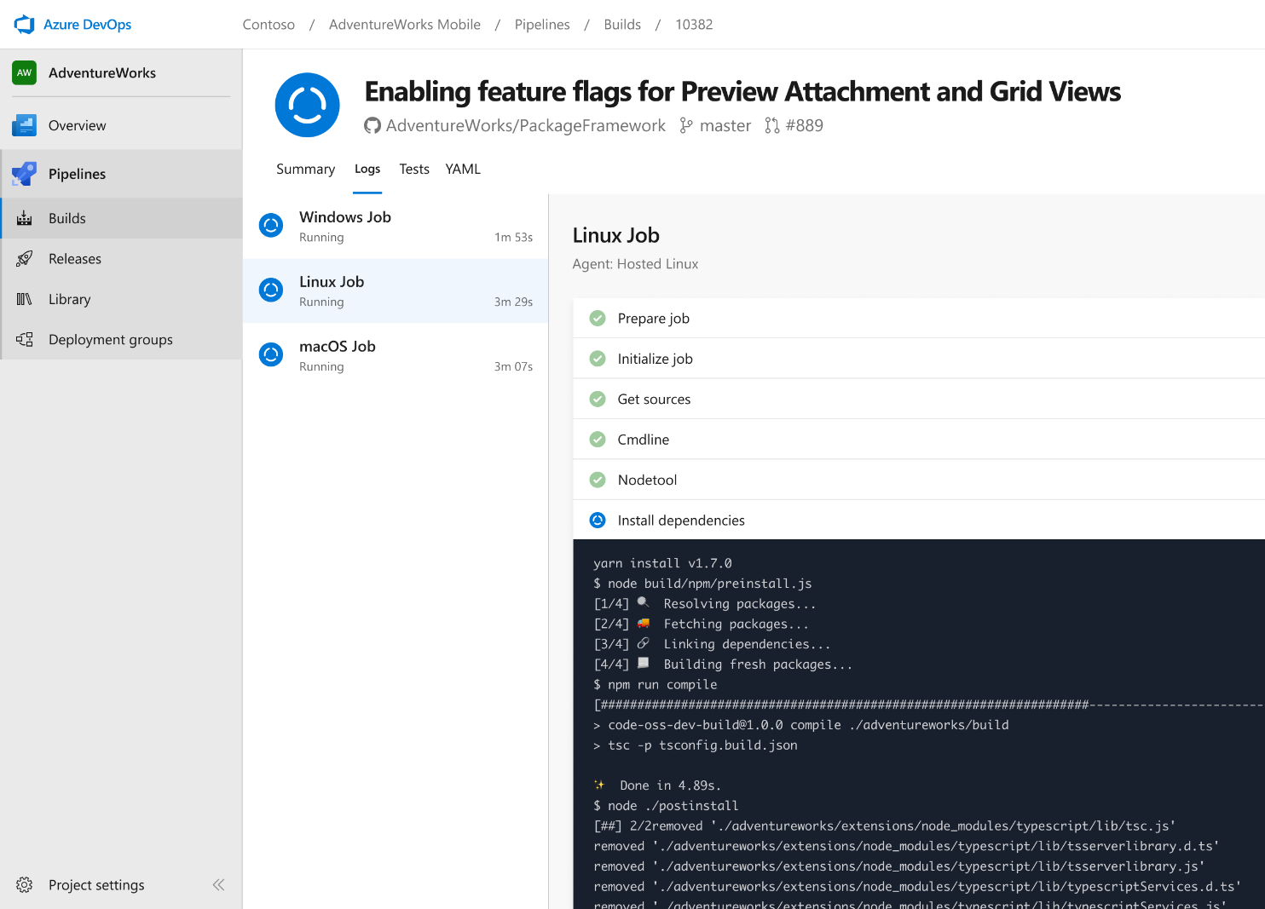
Azure DevOps – Get started for FREE
Open source
Unlimited public Git repos
Work item tracking and Kanban boards
10 FREE parallel jobs and unlimited build minutes for CI/CD
Private Projects (up to 5 users)
Unlimited private Git Repos
Work item tracking and Kanban boards
1 job with 1,800 minutes per month for CI/CD
➔
https://azure.com/devops

Slide 50
DevOps at Microsoft
Azure DevOps is the toolchain of choice for Microsoft internal engineering with over 90,000 internal users
➔
https://aka.ms/DevOpsAtMicrosoft
372k
Pull Requests per month
4.4m
Builds per month
5m
Work items viewed per day
78,000
Deployments per day
2m
Git commits per month
500m Test executions per day
500k
Work items updated per day
Data: Internal Microsoft engineering system activity, August 2018

Slide 51
Demo – Azure DevOps Project

Slide 52
5 Kubernetes Best Practices
Build small containers
Application architecture
  Use Namespaces
  Use helm charts
  RBAC
Implement Health checks
Set requests and limits
Be mindful of your services
  Map external services
  Don’t rely on load balancers

Slide 53
Developers
C#
F#
Linux
Tools
Cloud
Tools
Tools
Tools
DevOps
Data
ML
OSS
YOU
Microsoft

Slide 54
Please evaluate this session
Your feedback is important to us!
Please evaluate this session through MyEvaluations on the mobile app
or website.
Download the app:
https://aka.ms/ignite.mobileApp
Go to the website: https://myignite.techcommunity.microsoft.com/evaluations

