Slide 2
SDK Authentication and Secret Management
BRK3342
Josh Gavant, PM, Azure Tools

Slide 3
Agenda
Directory, identity, authentication
Authentication and secrets
Secret zero and other secrets
Authentication and secrets in SDKs and Apps
with demo!
Recap and resources

Slide 4
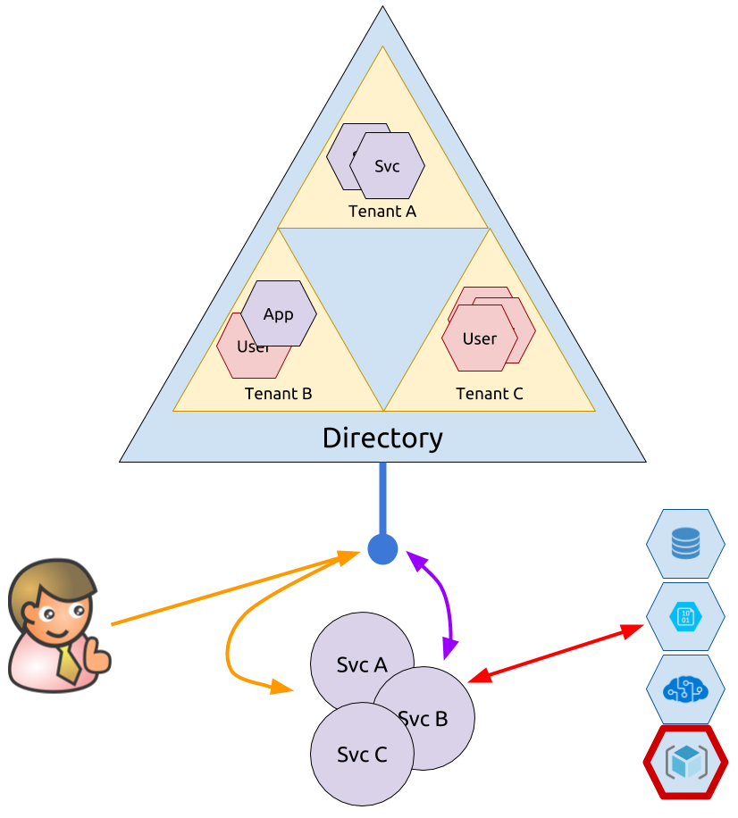
Directory, Identity, Authentication
Active Directory (AAD) is a central directory of principals in Azure.
It also provides protocol endpoints for authentication.
Tokens can represent apps (services) and/or users.

Slide 5
Others
Authorization
Resource Manager Role-Based Access Control (RBAC)
Key Vault Access Policies
Dataplane Accounts
Storage
Service Bus
CosmosDB
Cognitive

Slide 6
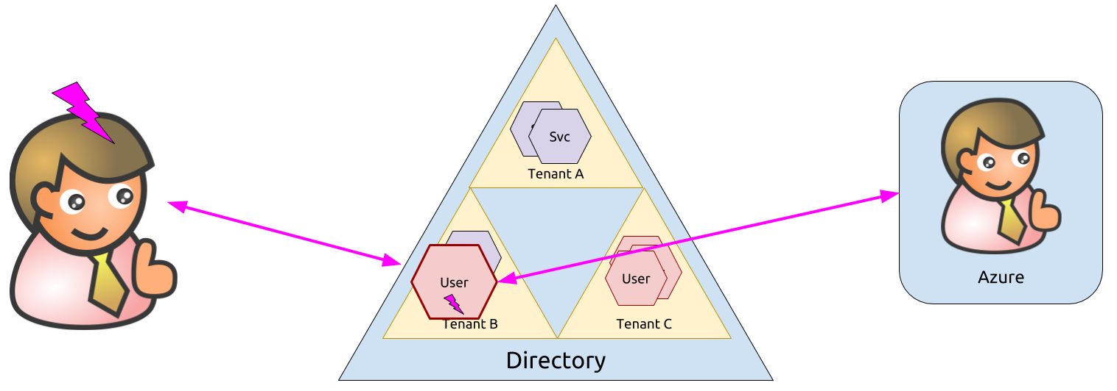
Authentication and Secrets
Authentication proves ownership of an identity. Can this be otherwise proven? Yes, platform can attest to identity – managed identity.

Slide 7
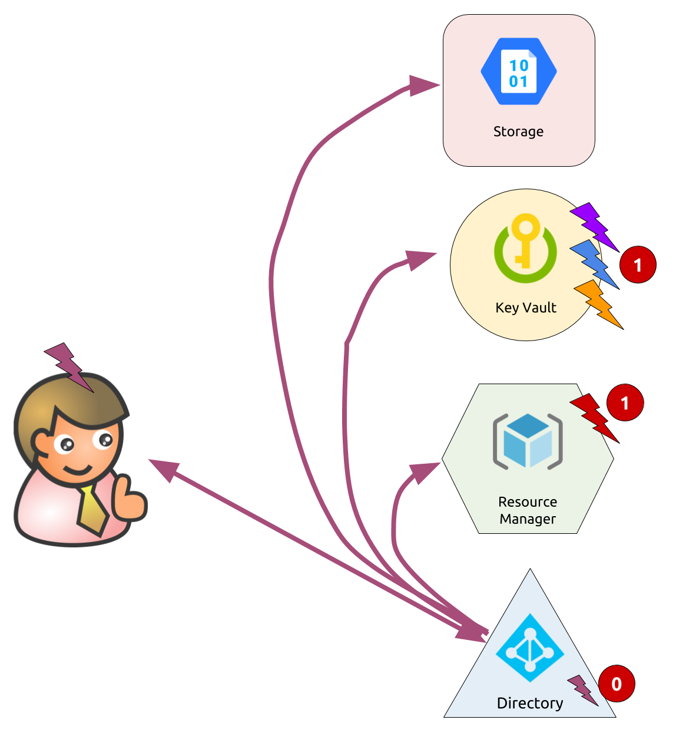
Secret zero and other secrets
Secret Zero is the hardest, then it can get easier.
Options for secret one (and two, three and four…):
Key Vault
Resource Manager
Or OAuth and no secrets ☺
What about client-side apps?
OAuth implicit flow: no secrets, but no app identity
Be careful with keys

Slide 8
Authentication and Secrets in SDKs and Apps
Store secrets in environment
Use `dotnet user-secrets` to store outside of code repo for ASP.NET.
Environment variables and plaintext files work with SDKs but are discouraged.
Get login tokens from CLI
`az account get-access-token`
Helpers in each SDK
Get secrets from Key Vault (or Hashicorp Vault).
Still requires local secret zero.
Use Managed Identity within Azure.
No secret zero needed!
Use OAuth/AAD whenever possible.

Slide 9
Demo: User Profiles App https://github.com/joshgav/UserProfilesApp

Slide 10
Recap
Avoid secret zero by using Managed Identity
Get other secrets from Key Vault (or Resource Manager)
Use OAuth when possible
Resources
Demo: https://github.com/joshgav/UserProfilesApp
Managed Identity: https://docs.microsoft.com/azure/active-directory/managed-identities-azure-resources/
Key Vault: https://docs.microsoft.com/azure/key-vault/
Storage with OAuth: https://docs.microsoft.com/rest/api/storageservices/authenticate-with-azure-active-directory

Slide 11
Please evaluate this session Your feedback is important to us!
Please evaluate this session through MyEvaluations on the mobile app or website.
Download the app: https://aka.ms/ignite.mobileApp
Go to the website: https://myignite.techcommunity.microsoft.com/evaluations

