Slide 2
Lessons Learned: ARM Template Best Practices – Part 1
THR2387
Justin Yoo @justinchronicle
Microsoft MVP – Azure | Developer Technlogies
Senior Consultant | Mexia

Slide 3
What Will Cover
Writing ARM Template
Testing ARM Template
Deploying ARM Template
Managing ARM Template Deployment Histories

Slide 4
Demo: Invoke ARM Template Build Pipeline on Azure DevOps

Slide 5
What Is ARM Template?

Slide 6
About ARM Template
JSON format
Azure resource definitions in a resource group
Reusability and declarativity
Lifecycle management

Slide 7
Writing ARM Template

Slide 8
Forget JSON, Use YAML
Superset of JSON
Better readability
No more opening/closing braces & brackets
Comments!

Slide 9
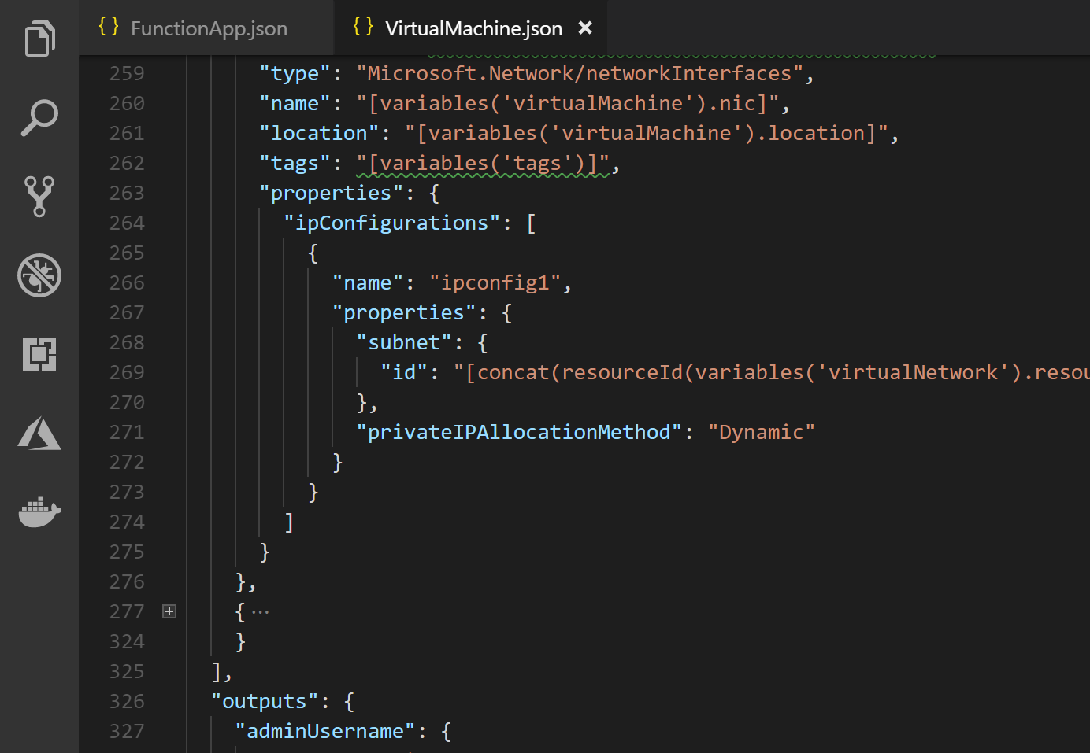
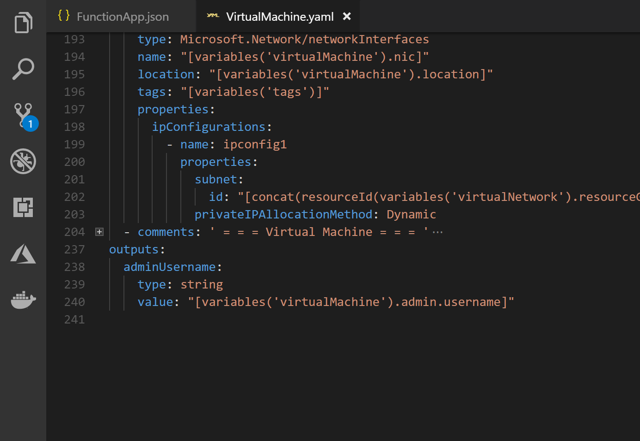
Forget JSON, Use YAML

Slide 10
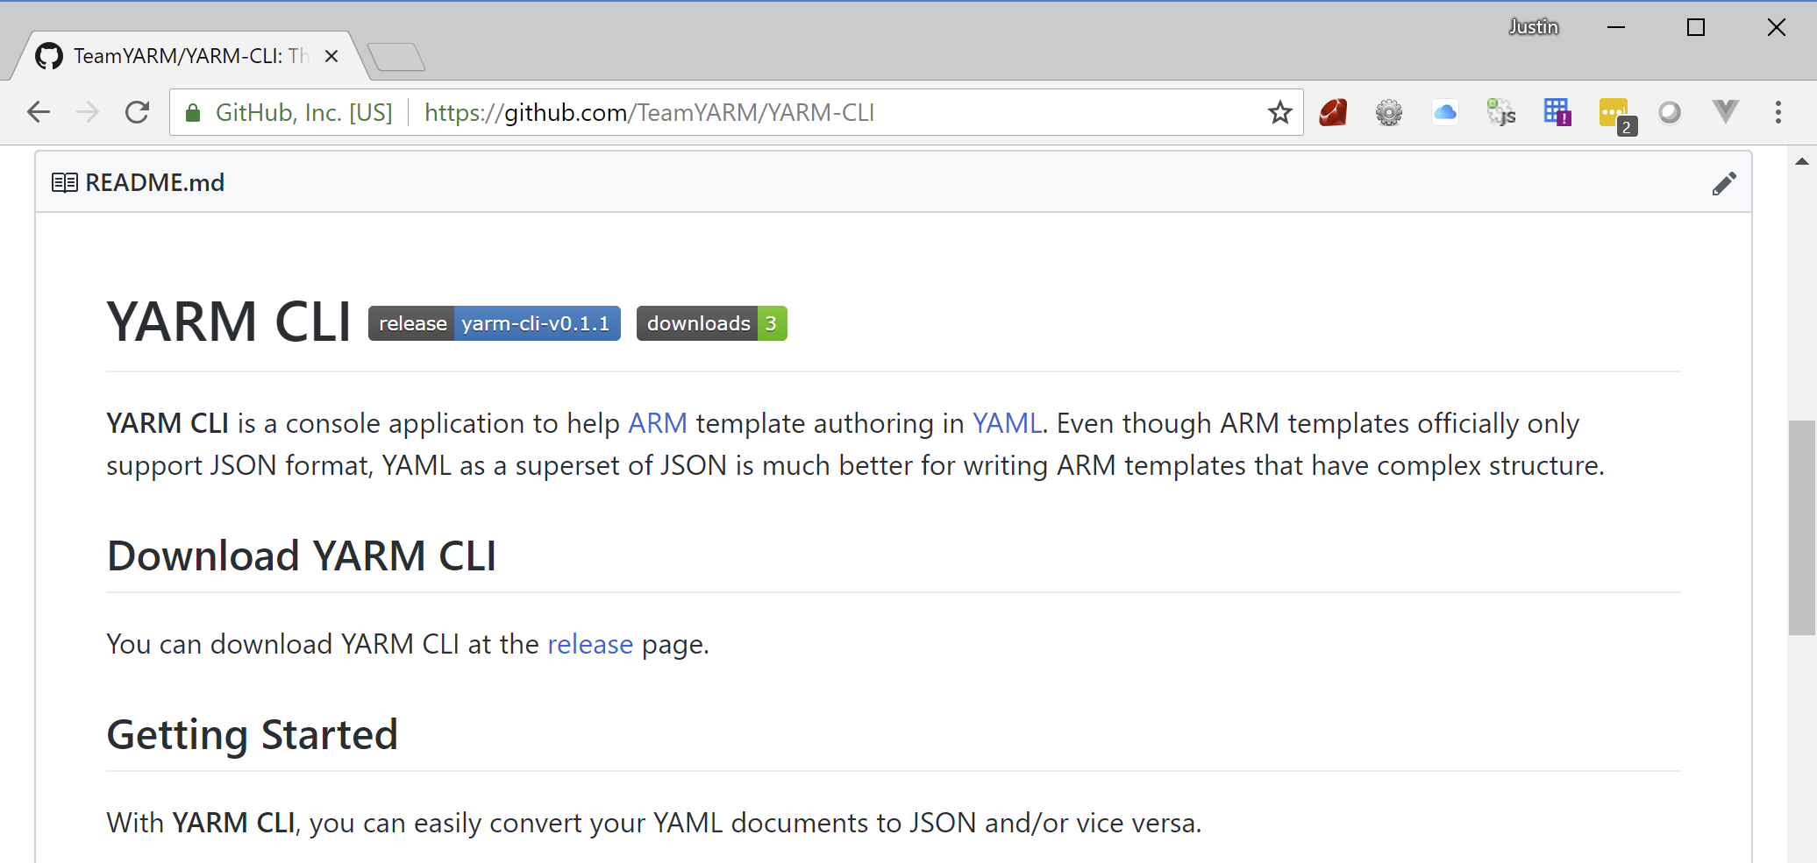
Forget JSON, Use YAML
yarm-cli
Cross-platform command-line application
Converts ARM templates written in YAML to JSON

Slide 11
Demo: How to Convert JSON to YAML and Vice-Versa
Using yarm-cli

Slide 12
Demo: How ARM Templates Converted and Tested in Build Pipeline
Using yarm-cli, Azure CLI and Pester

Slide 13
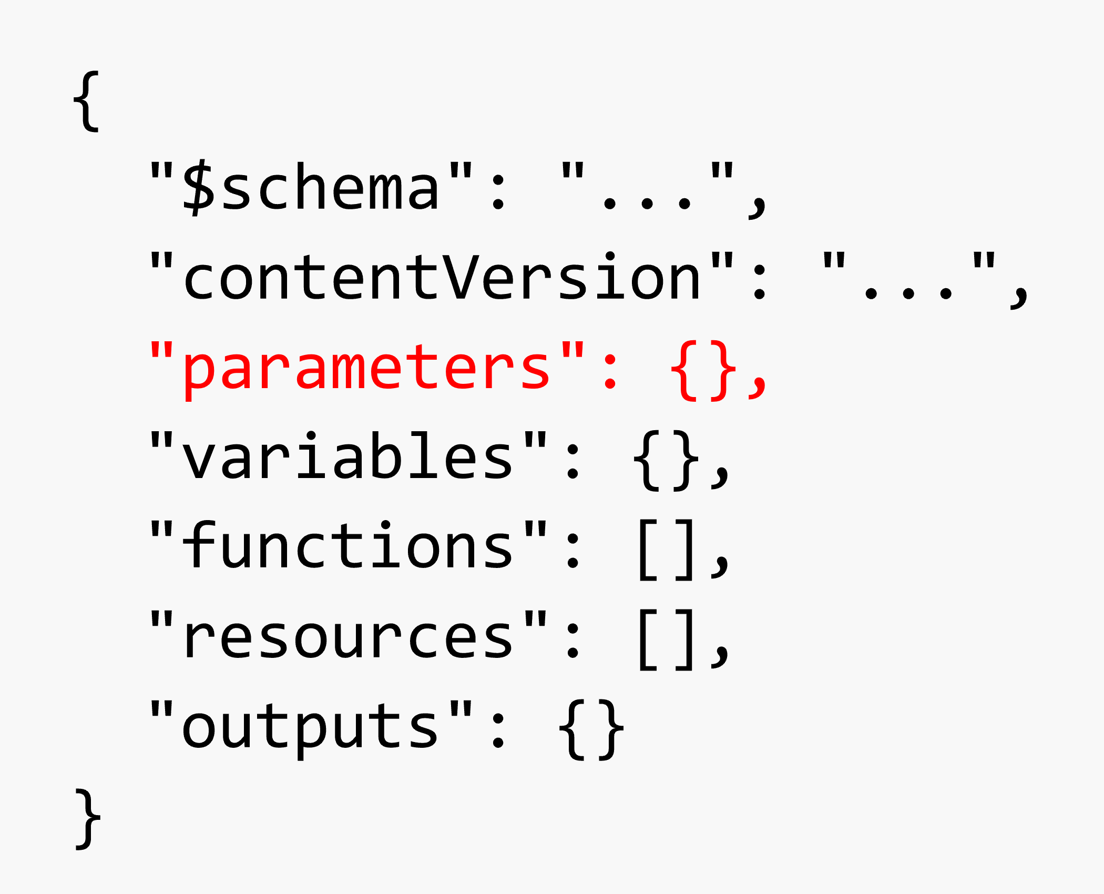
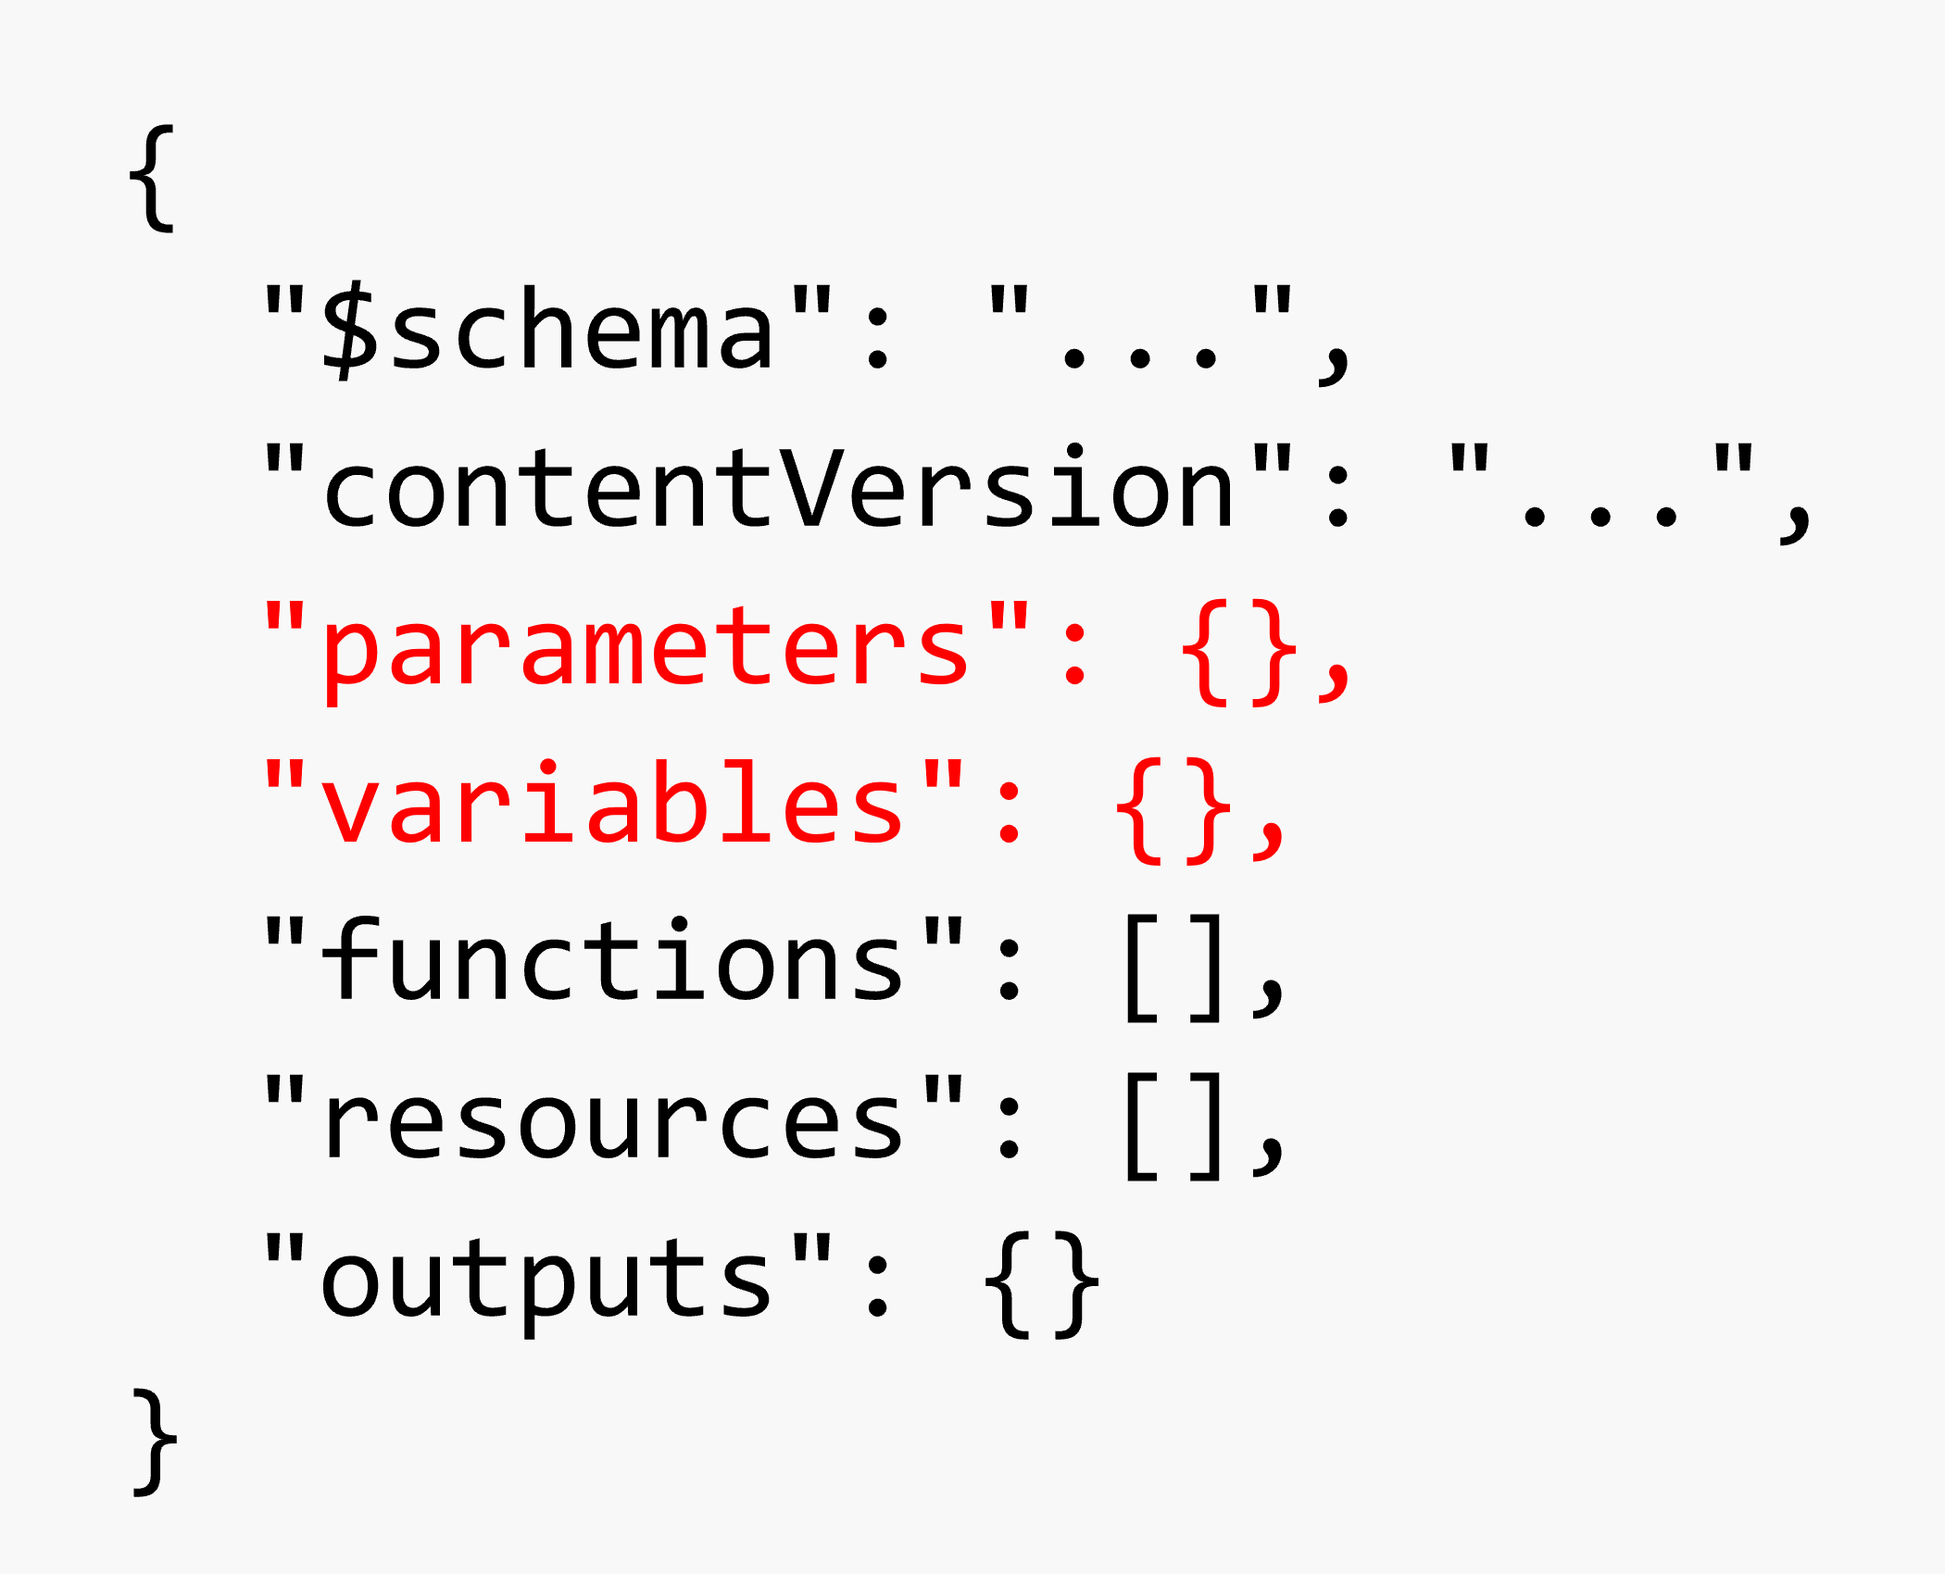
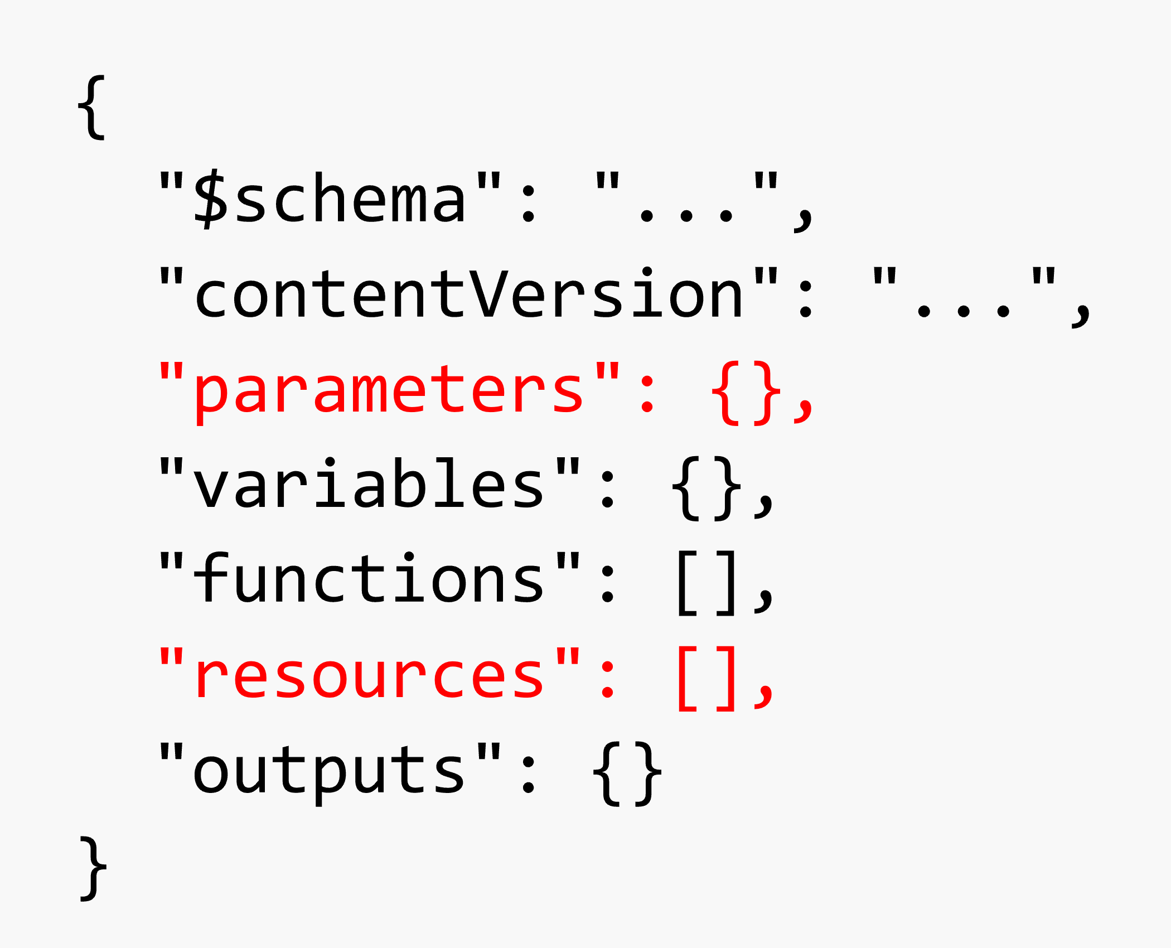
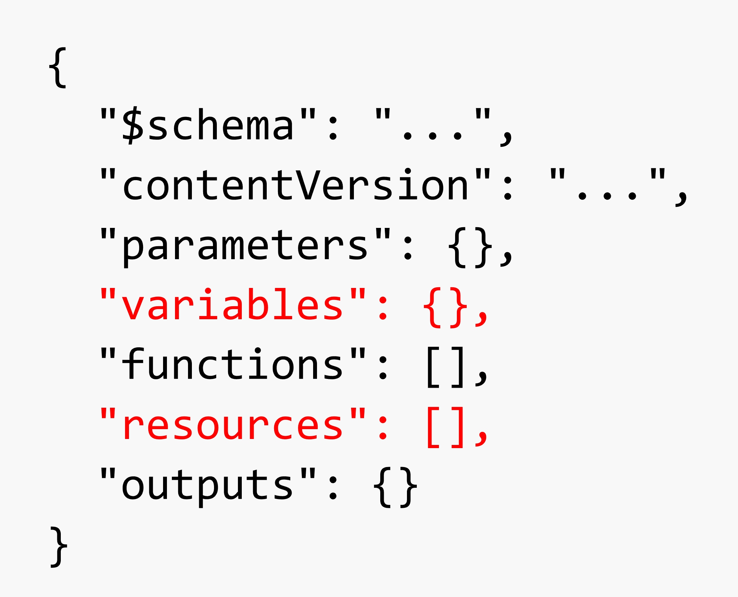
Use `parameters` `variables` for `resources`
YES: `parameters` take inputs
YES: `parameters` pass to `variables`
YES: `variables` handle `parameters`
NO: `parameters` talk to `resources`
YES: `variables` talk to `resources`

Slide 14
Use `functions`
Simplifies complex expressions
Reusable within ARM template

Slide 15
Use `functions`
functions:
- namespace: fairdincom
members:
getResourceName:
parameters:
- type: string
name: fullname
- type: string
name: suffix
output:
type: string
value: "[replace(parameters('fullname'), '{0}', parameters('suffix'))]"

Slide 16
Use `functions`
variables:
fullname: "[concat(parameters('prefix'), '-{0}-', parameters('location'))]"
functionApp: "[fairdincom.getResourceName(variables('fullname'), 'fncapp')]"
logicApp: "[fairdincom.getResourceName(variables('fullname'), 'logapp')]"
serviceBus: "[fairdincom.getResourceName(variables('fullname'), 'svcbus')]"

Slide 17
Use `outputs`
Visualize results from the deployment
Very handy in the release pipeline for references

Slide 18
Use `outputs`
outputs:
applicationInsightsInstrumentationKey:
type: "string"
value: "[reference('resourceName').instrumentationKey]"
storageAccountKey:
type: "string"
value: "[listKeys('resourceId', 'apiVersion').keys[0].value]"
eventGridTopicEndpointUrl:
type: "string"
value: "[reference('resourceName').endpoint]"

Slide 19
Testing ARM Template

Slide 20
Don’t Use PowerShell Cmdlet for Testing
Test-AzureRmResourceGroupDeployment
Bad for deployment behaviors over validation
Bad for error handling

Slide 21
Use Azure CLI as Testing Tool
az group deployment validate
Good for deployment behavior and error handling

Slide 22
Use Pester as Testing Framework
PowerShell testing framework
BDD style testing
Windows out-of-the-box

Slide 23
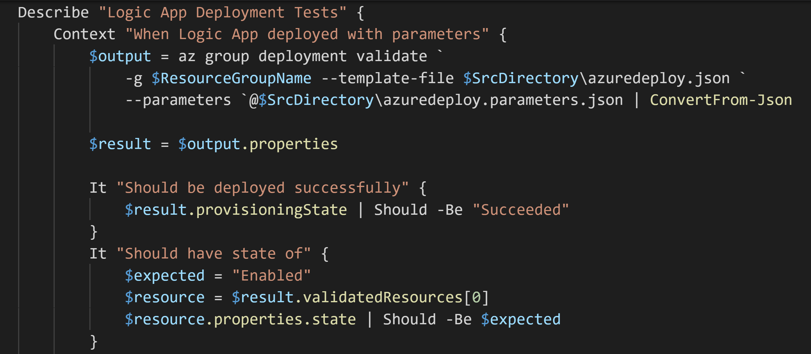
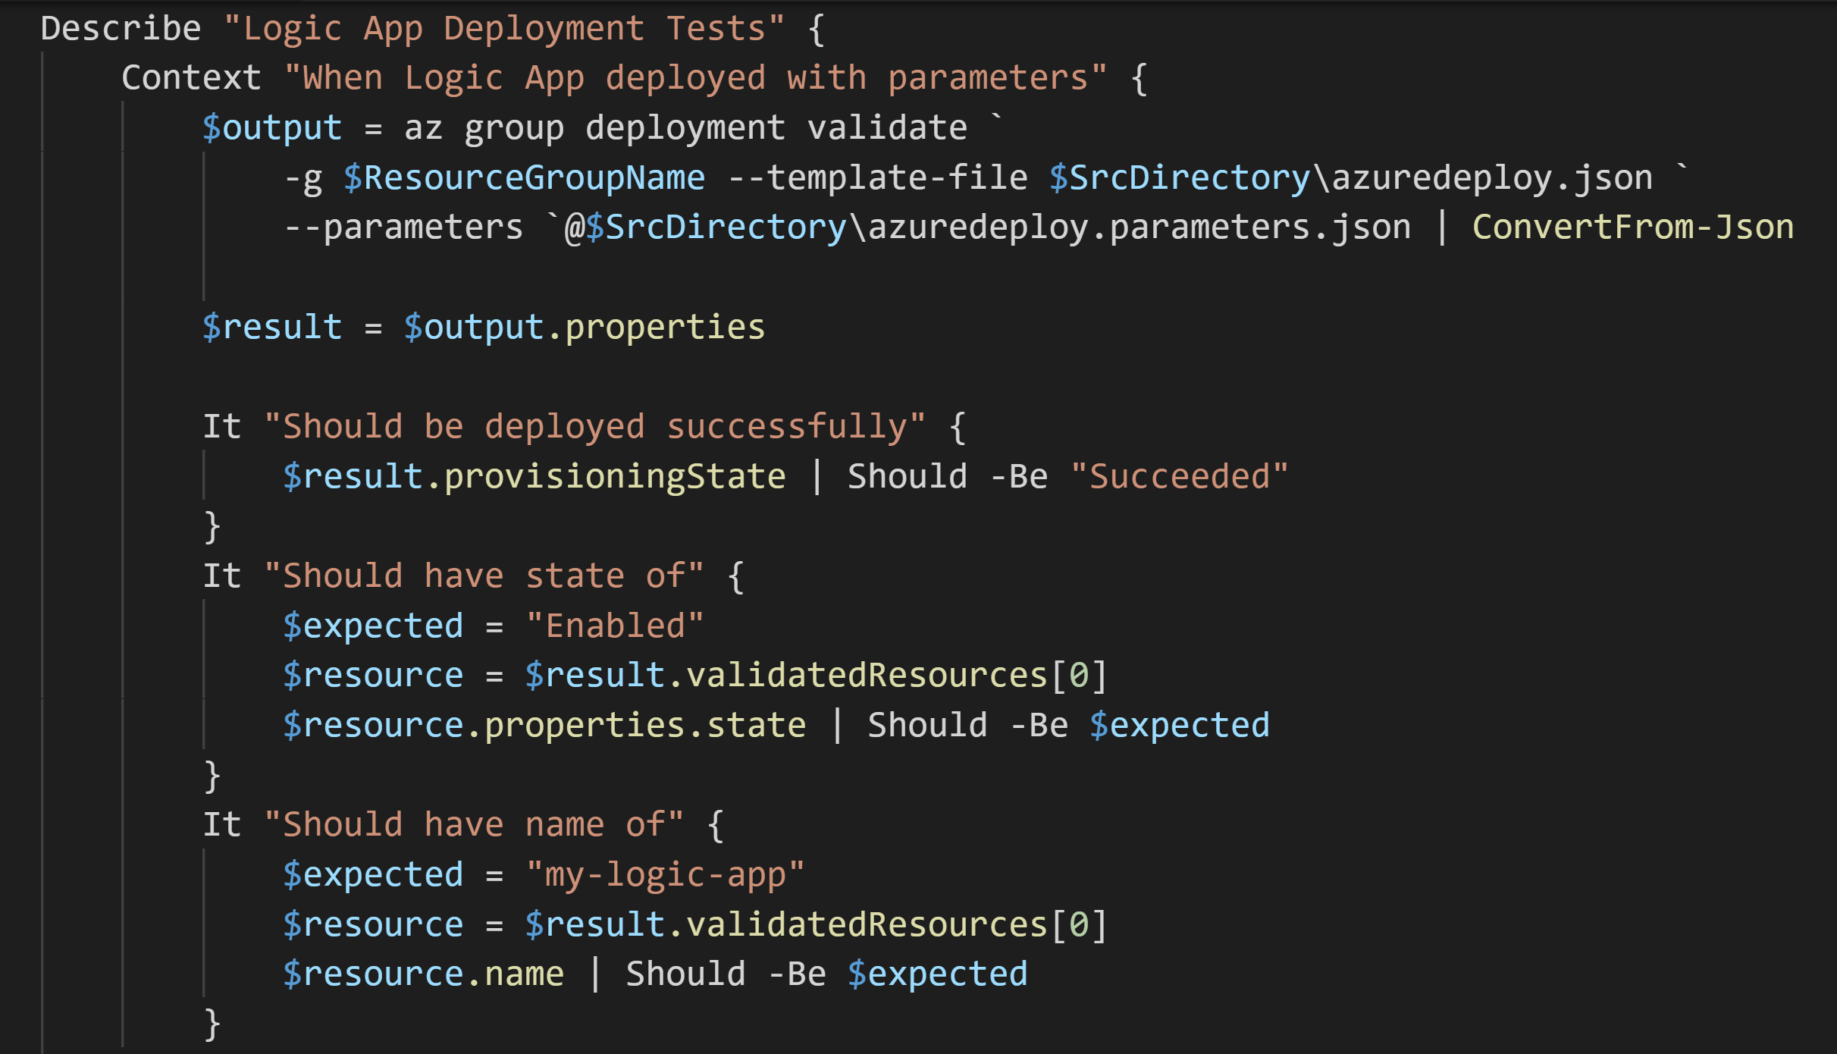
Use Pester

Slide 24
Use Pester

Slide 25
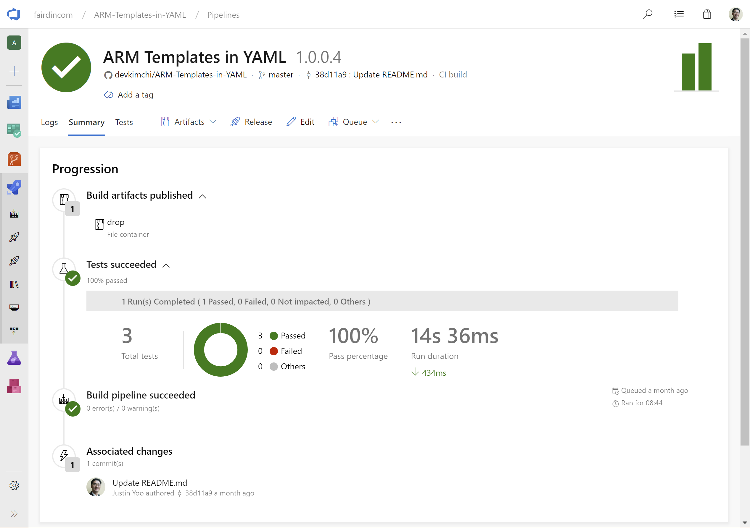
Use Pester

Slide 26
Demo: Test Results from the Previous Demo
Using yarm-cli, Azure CLI and Pester

Slide 27
What Have Covered
Writing ARM Template
Testing ARM Template
Deploying ARM Template
Managing ARM Template Deployment Histories

Slide 28
Questions?

Slide 29
Resources
YARM CLI: bit.ly/yarm-cli
ARM Templates in YAML: bit.ly/arm-templates-in-yaml
Azure Quickstart Templates: bit.ly/arm-quickstart

Slide 30
Thank You!
Justin Yoo Microsoft MVP – Azure | Developer Technologies
@justinchronicle
devkimchi.com
/in/justinyoo

Slide 31
Please evaluate this session Your feedback is important to us!
Please evaluate this session through MyEvaluations on the mobile app or website.
Download the app: https://aka.ms/ignite.mobileApp
Go to the website: https://myignite.techcommunity.microsoft.com/evaluations

