Slide 2
Lessons Learned: ARM Template Best Practices – Part 2
Session code here
Justin Yoo @justinchronicle
Microsoft MVP – Azure | Developer Technologies
Senior Consultant | Mexia

Slide 3
What Have Covered
Writing ARM Template
Testing ARM Template
Deploying ARM Template
Managing ARM Template Deployment Histories

Slide 4
What Will Cover
Writing ARM Template
Testing ARM Template
Deploying ARM Template
Managing ARM Template Deployment Histories

Slide 5
Demo: How to Manage Deployment History through Azure Logic App
ARM Template Deployment History Management

Slide 6
What Is ARM Template?

Slide 7
About ARM Template
JSON format
Azure resource definitions in a resource group
Reusability and declarativity
Lifecycle management

Slide 8
Deploying ARM Template

Slide 9
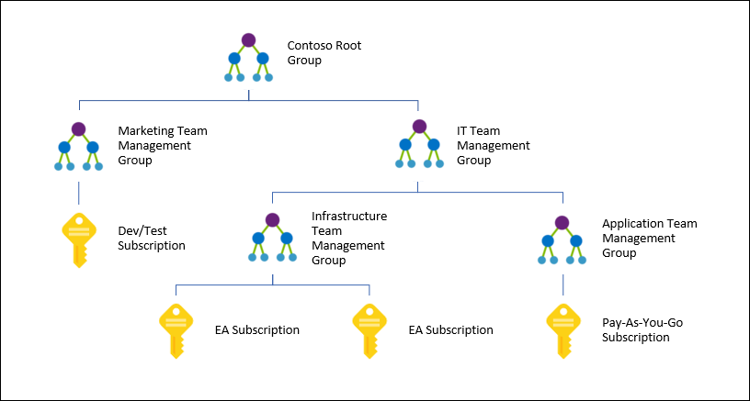
Use Management Group for Access and Policies
RBAC on resource group
RBAC on subscription
RBAC on management group

Slide 10
Use One Template for One Resource
Single Responsibility
Reusability
Maintainability
Orchestration by linked template or CI/CD pipeline

Slide 11
Don’t Use Linked ARM Template
Parallel deployment orchestration
Not recommended
Child templates publicly accessible
Extra steps required even before testing
Parameters usage limited

Slide 12
Use CI/CD Pipeline for ARM Template Deployment
Recommended
Child templates stay within the pipeline
No need external references
Both parameters object and parameters file available
Azure DevOps supports parallel deployment orchestration

Slide 13
Demo: Orchestrating ARM Template Deployment in CI/CD Pipeline
Use Azure DevOps

Slide 14
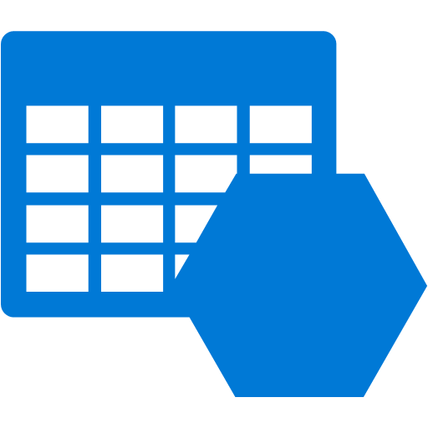
ARM Template Dependency
Storage Connector
Table Storage
Logic App
ARM Connector

Slide 15
Managing ARM Template Deployment History

Slide 16
Deployment History
800
800: Maximum number of deployment name in one resource group
Easy to exceed with Logic App, API Management, Data Factory
Monitor threshold carefully
Backup for auditing
Table Storage, Cosmos DB, etc

Slide 17
Demo: Failing ARM Template Deployment in CI/CD Pipeline
Use Azure DevOps

Slide 18
History Management
Takes 30-60 secs per deployment history to delete
when using ARM REST API
PowerShell: Remove-AzureRmResourceGroupDeployment
Azure CLI: az group deployment delete
NO: PowerShell – 400+ mins (6+ hrs) for entire history
Parallel for-each loop not supported
YES: Logic App – 15-17 mins for entire history
Parallel for-each loop supported

Slide 19
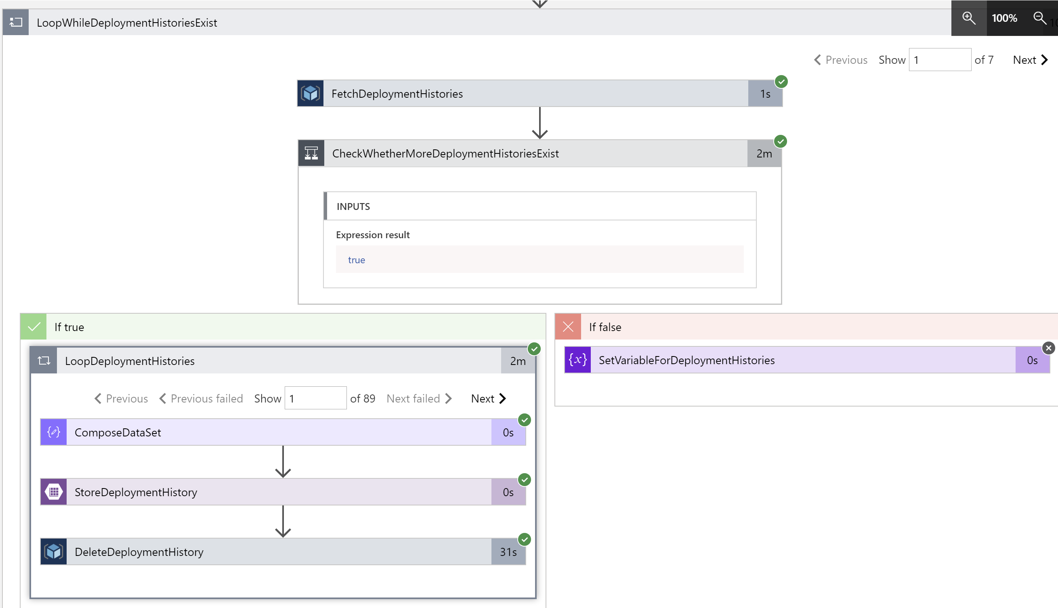

Slide 23
Demo: Clearing ARM Template Deployment History via Logic App
The Logic App run result

Slide 24
What Have Covered
Writing ARM Template
Testing ARM Template
Deploying ARM Template
Managing ARM Template Deployment Histories

Slide 25
Questions?

Slide 26
Resources
Azure Management Groups: bit.ly/azure-management-groups
ARM Deployment History Cleaner: bit.ly/arm-deployment-history-cleaner

Slide 27
Thank You!
Justin Yoo Microsoft MVP – Azure | Developer Technologies
@justinchronicle
devkimchi.com
/in/justinyoo

Slide 28
Please evaluate this session Your feedback is important to us!
Please evaluate this session through MyEvaluations on the mobile app or website.
Download the app: https://aka.ms/ignite.mobileApp
Go to the website: https://myignite.techcommunity.microsoft.com/evaluations

