Slide 2
How Microsoft Keeps Its DevOps Services Secure
THR3109
Edward Thomson @ethomson
Program Manager, Azure DevOps

Slide 3
Edward Thomson
Program Manager: Azure DevOps
ethomson@microsoft.com
Twitter, GitHub: @ethomson

Slide 4
What is DevOps?
“It’s a job title”
“It’s automation”
“It’s Development and Operations collaboration”
“It means faster and smaller releases”

Slide 5
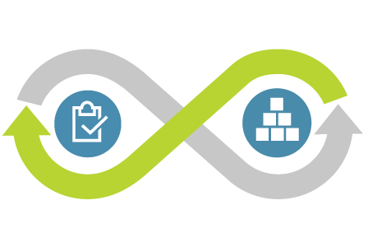
What is DevOps?
DevOps is the union of people, process, and tools to enable continuous delivery of value to our customers.
Increase flow of value
Shorten cycle times
Continuously Improve

Slide 6
What is DevSecOps?
DevSecOps is ensuring that we can use these modern practices, and deliver value quickly, but still keep our services secure.
Increase flow of value
Shorten cycle times
Continuously Improve

Slide 7
Mindset Shift: Assume Breach
Fundamentally, if somebody wants to get in, they’re getting in… accept that.
Michael Hayden
Former Director, NSA and CIA

Slide 8
DevSecOps How Modern Practices Can Help

Slide 9
The Two Widest Back Doors
Credential Theft
Finding Known Vulnerabilities

Slide 10
Credential Theft

Slide 11
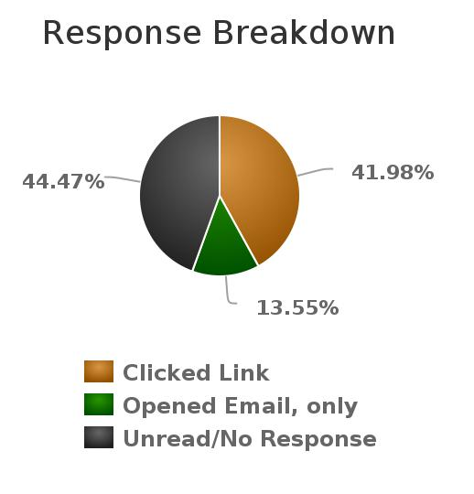
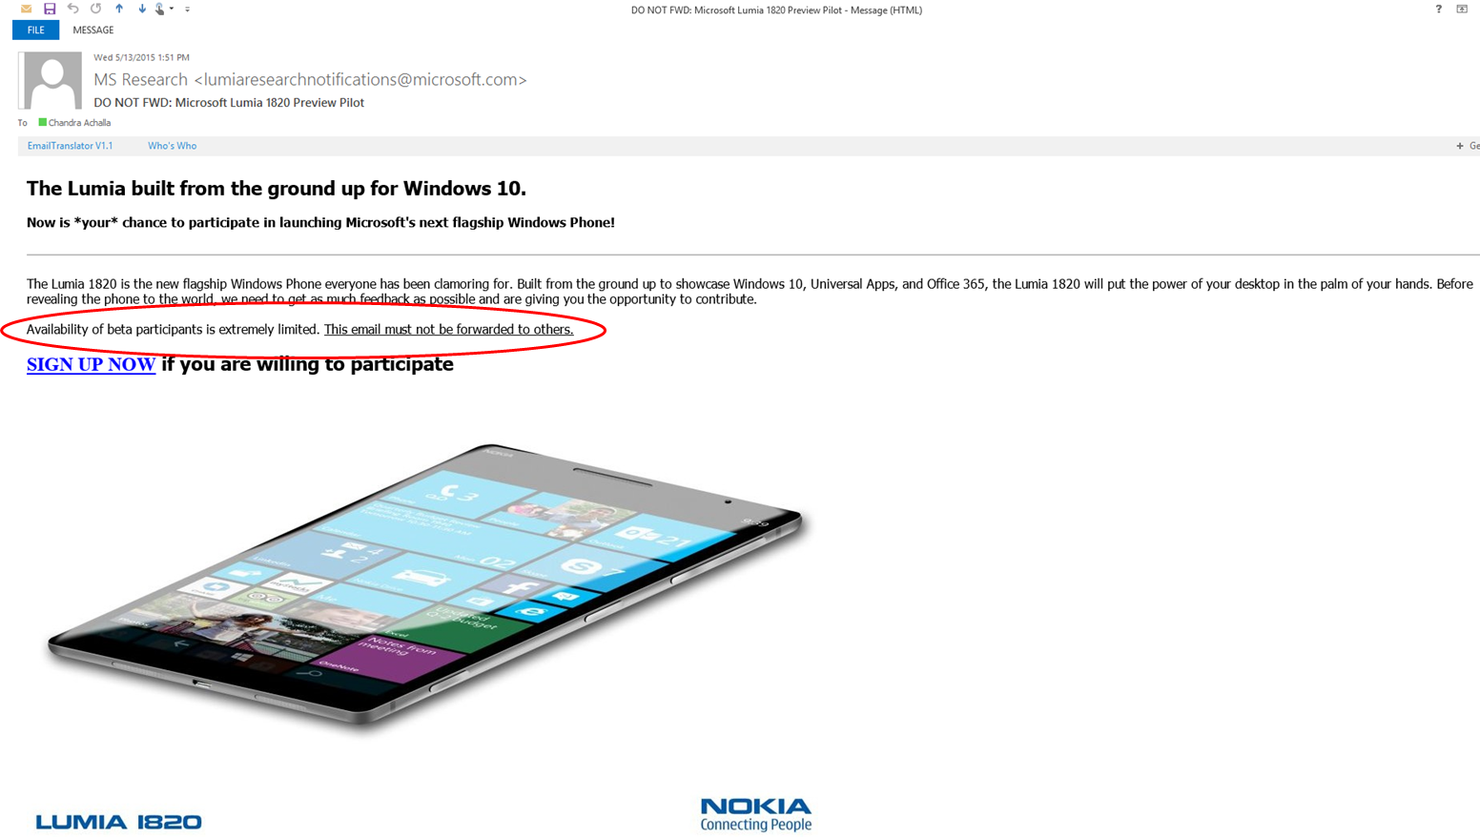
Theft By Phishing
Email: Nokia 1820 Lumia
Total population of 524 people.
220 people clicked on signup button. 37 people clicked on both phishing emails
Only 11 people reported to as probable phish

Slide 12
Identity Protection
Multi-Factor Authentication
Link wrapping for incoming email; e.g.
https://na01.safelinks.protection.outlook.com/?url=http%3A%2F%2Fmailer.dzone.com%2Flink.php%3FM%3D30478924%26N%3D14289%26L%3D109365%26F%3DH&data=02%7C01%7Cethomson%40microsoft.com%7Cb5c12aafabd249019afe08d592513b01%7C72f988bf86f141af91ab2d7cd011db47%7C1%7C0%7C636575799936335520&sdata=%2BRQfR42jnZCti8pD7RKLbQMZV7wAl4Q%2BncMlx2Z8IEE%3D&reserved=0

Slide 13
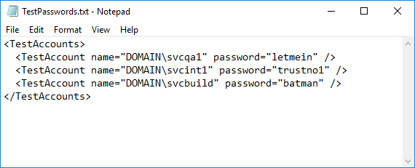
Another Source of Leak: Credentials in a File
What do plaintext credentials look like?
Every team seems to experience this one at the beginning.

Slide 14
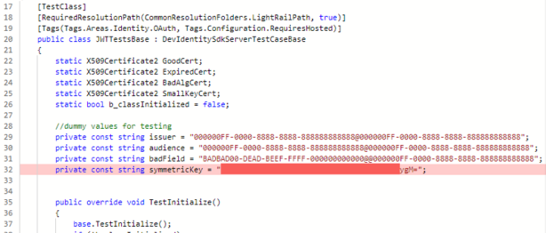
Example: Credentials in Code

Slide 15
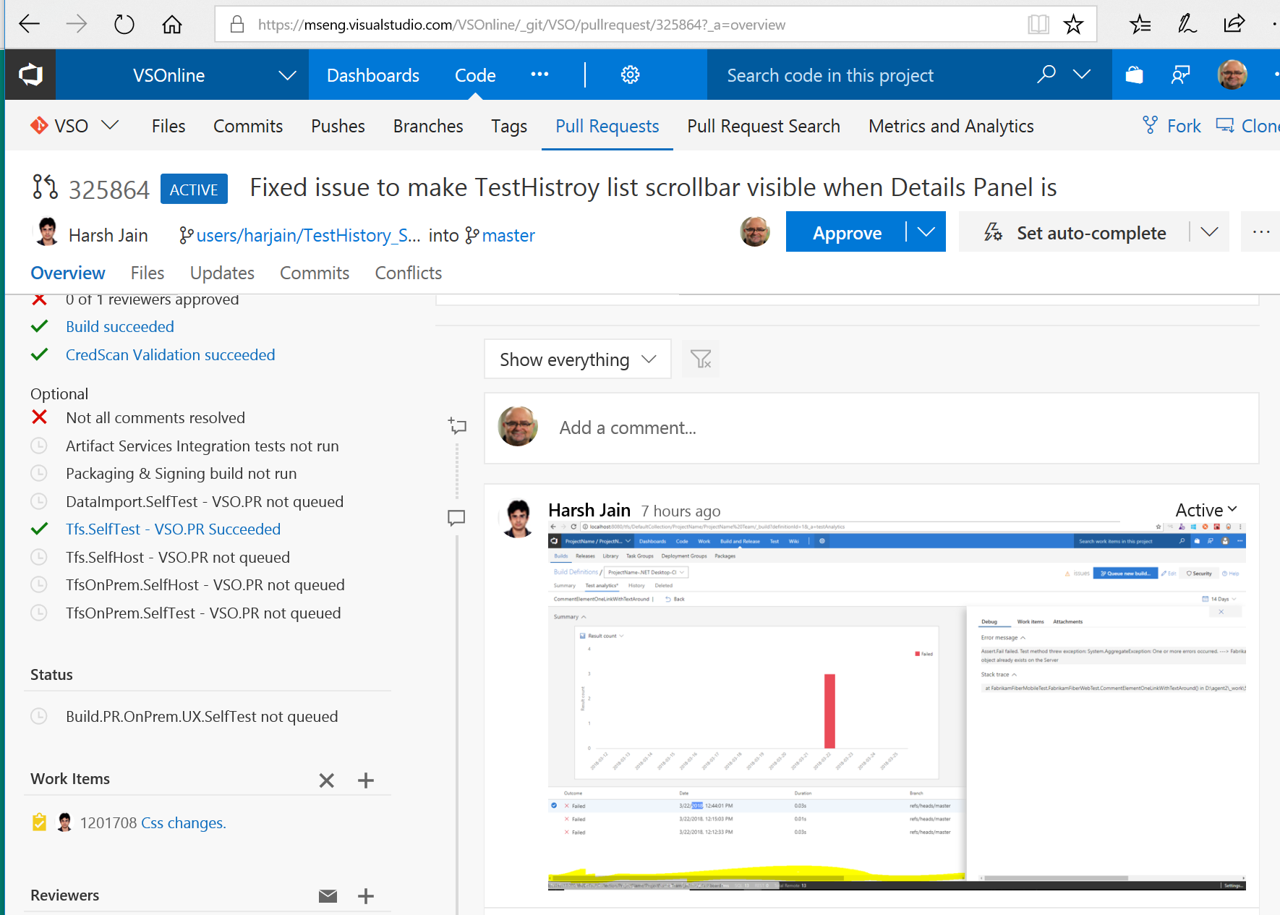
Credential Scanning
VSTS examines pull requests with a branch policy that scans for credential leakage.

Slide 16
Credential Scanning
Scan source code and data files for patterns: access keys, connection strings, certificates, etc.
<ContentSearcher>
<Name>VstsPersonalAccessToken</Name>
<RuleId>CSCAN0240</RuleId>
<ResourceMatchPattern>\.(cs|ps1|bat|config|xml|json)$</ResourceMatchPattern>
<ContentSearchPatterns>
<string>AccessToken.*?['="][a-z0-9]{52}('|"|\s|[\r\n]+)</string>
<string>[>|'|=|"][a-zA-Z0-9/+]{70}==</string>
<string>password\s+[a-z0-9]{52}(\s|[\r\n]+)</string>
</ContentSearchPatterns>
<MatchDetails>Found Vsts personal access token in source file.</MatchDetails>
<Recommendation>Validate file contains secrets, remove, roll credential, and use approved store.</Recommendation>
<Severity>3</Severity>
</ContentSearcher>

Slide 17
Known Vulnerabilities in Open Source Components

Slide 18
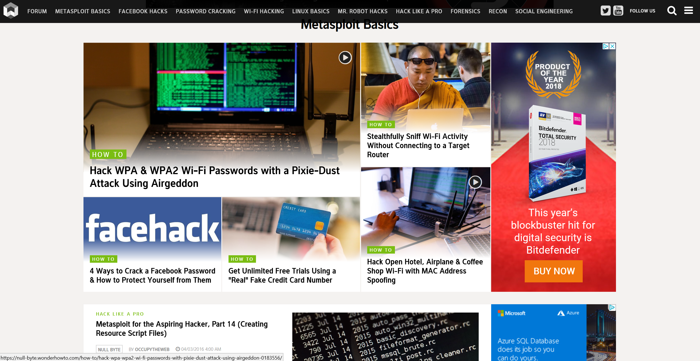
How to Find Known Vulnerabilities

Slide 19
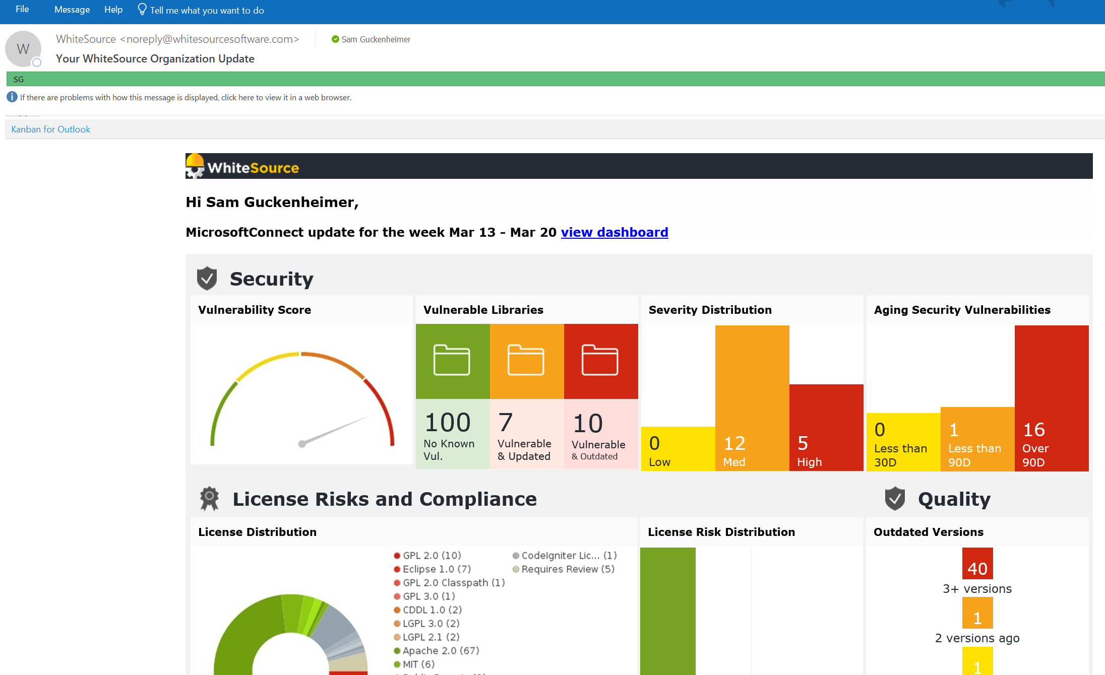
Scan Your OSS Components

Slide 20
Package Management
Binary artifacts are accessed via a trusted feed and scanned for vulnerability
Builds produce artifacts that are managed
OSS dependencies are scanned for vulnerabilities and kept up to date

Slide 21
Additional Practices

Slide 22
Red Teams

Slide 23
Evolution of Red vs Blue
Earlier
Identify vulnerabilities through manual code review
Engage external pen testing company
Report out to the team, fixes added to the backlog
2015
Paired a handful of security-minded engineers with a pen tester (Red team)
A few ops-minded engineers that understand the systems & logging available (Blue team)
Attacks were successful due to poorly protected secrets, SQL injection & successful phishing campaigns
2016
Augment both teams with outside experts (AD security and IT Security Incident Response experts)
Comprehensive, centralized logging available for Blue team to do post-breach forensics
Attacks were based upon Cross-site scripting (XSS), deserialization, & engineering system vulnerabilities
2017
Red team taking longer to reach objectives. Forced to find & chain 5-6 different vulnerabilities together
With Kalypso monitors, Blue team is starting to catch Red team in real-timea

Slide 24
Secure and Compliant Pipeline

Slide 25
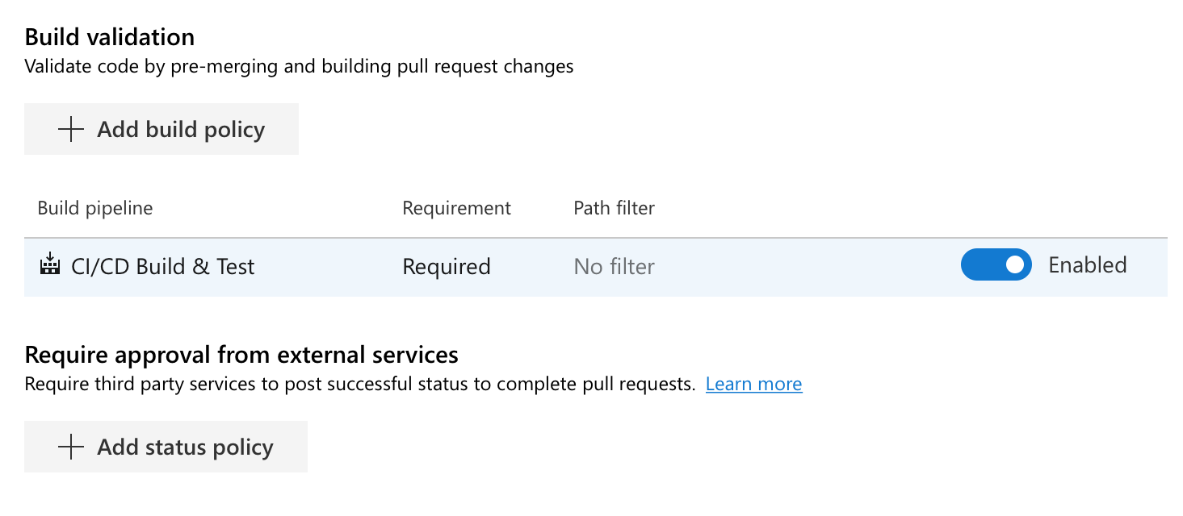
Pull Requests
Single Master/Trunk-based development
Branch policies require pull requests; disable pushing directly to master
Enforces CI/CD build pipelines

Slide 26
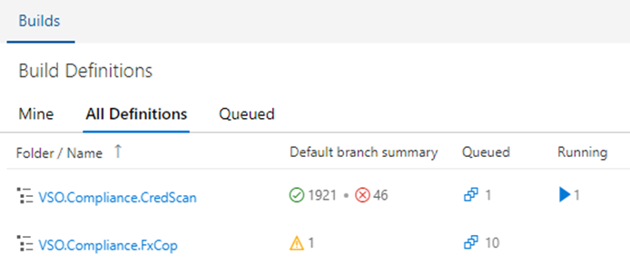
Pipeline Security Tools
Credential scanners
FxCop / Static Analysis
OWASP Scanners
SSL Scanners
OSS Compliance

Slide 27
Pipeline Security Tools
Credential scanners
FxCop / Static Analysis
OWASP Scanners
SSL Scanners
OSS Compliance
Available in the Azure DevOps Marketplace

Slide 28
Pipeline Security Tools
Credential scanners
FxCop / Static Analysis
OWASP Scanners
SSL Scanners
OSS Compliance
Available in the Azure DevOps Marketplace

Slide 29
Thanks!
Edward Thomson
ethomson@microsoft.com
@ethomson

Slide 30
Please evaluate this session Your feedback is important to us!
Please evaluate this session through MyEvaluations on the mobile app or website.
Download the app: https://aka.ms/ignite.mobileApp
Go to the website: https://myignite.techcommunity.microsoft.com/evaluations

